Slide 1
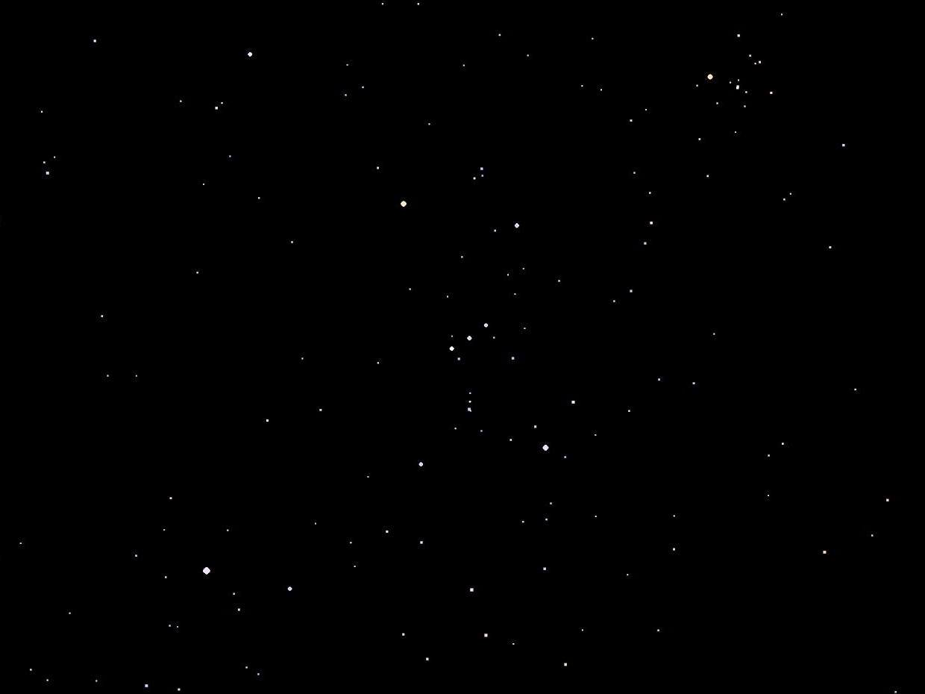
Orion

Slide 2
Orion

Slide 3
Orion
Betelgeuse
Bellatrix
Mintaka
Alnitak
Alnilam
Rigel
Saiph
Sirius

Slide 4
Orion
500 ly
250 ly
700 ly
700 ly
2000 ly
900 ly
600 ly
8.6 ly

Slide 5
Orion
Betelgeuse
Bellatrix
Mintaka
Alnitak
Alnilam
Rigel
Saiph
Sirius

Slide 6
Orion
Betelgeuse 500 ly
Bellatrix 250 ly
Mintaka 700 ly
Alnitak 700 ly
Alnilam 2000 ly
Rigel 900 ly
Saiph 600 ly
Sirius 8.6 ly

