Slide 1

February 25, 2021

Slide 2
Remote Meeting Instructions Brandon Allgier
This meeting is being recorded.
If you want to make a comment, please raise your hand or put your comment in the chat.
Any comment in the chat will be addressed for the recording.
If you are joining via phone, you will be muted initially. During Public Comments, your phone will be un-muted and you will be able to make a comment if desired. You may also need to press “*6” to unmute your line.
Notes:
Remember to record meeting

Slide 3

Technology Advisory Board
Agenda
Public Comments - Chair - 3 min
Approve Minutes from 12/10/20 Meeting - Chair - 2 min
Nominations & Voting for 2021 TAB Chair & Vice-Chair – Chair – 10 min
COVID-19 Update (Informational) – Zach Posner – 5 min
Follow-Up Items:
County-Wide Website Redesign Update (Informational) – Megan Hillyard– 5 min
SharePoint Document Management Update (Informational) – Tony Jolley– 5 min
Working Groups Membership (Informational) – Tony Jolley – 10 min
Working Groups Milestone Chart (Discussion/Direction) – Tony Jolley– 3 min
IT Working Group Updates:
GWG – IT Policy & Standards Update – (Discussion/Approval) – Mark Evans – 10 min
Technology Positions County-wide update (Discussion/Direction) – Heather Hancock – 10 min
Data Governance Working Group Update (Informational) – Javaid Lal – 10 min
Communication Items - Mayor & Council – Zach Posner & Chair – 1 min
Upcoming Meeting Schedule (Discussion/Direction) – Kristine Pepin - 1 min
Review Action Items – Kristine Pepin - 2 min
Next Meeting – 4/22/21 – Chair - 1 min

Slide 4
Technology Advisory Board
Agenda
Public Comments - Chair - 3 min (9:00 – 9:03)
Approve Minutes from 12/10/20 Meeting - Chair - 2 min (9:03 – 9:05)
Nominations & Voting for 2021 TAB Chair & Vice-Chair – Chair – 10 min (9:05 – 9:15)
COVID-19 Update (Informational) – Zach Posner – 5 min (9:15 – 9:20)
Follow-Up Items:
County-Wide Website Redesign Update (Informational) – Megan Hillyard– 5 min (9:20 – 9:25)
SharePoint Document Management Update (Informational) – Tony Jolley– 5 min (9:25 – 9:30)
Working Groups Membership (Informational) – Tony Jolley – 10 min (9:30 – 9:40)
Working Groups Milestone Chart (Discussion/Direction) – Tony Jolley– 3 min (9:40 – 9:43)
IT Working Group Updates:
GWG – IT Policy & Standards Update – (Discussion/Approval) – Mark Evans – 10 min (9:43 – 9:53)
Technology Positions County-wide update (Discussion/Direction) – Heather Hancock – 10 min (9:53 – 10:03)
Data Governance Working Group Update (Informational) – Javaid Lal – 10 min (10:03 – 10:13)
Communication Items - Mayor & Council – Zach Posner & Chair – 1 min (10:13 – 10:14)
Upcoming Meeting Schedule (Discussion/Direction) – Kristine Pepin - 1 min (10:14 – 10:15)
Review Action Items – Kristine Pepin - 2 min (10:15 – 10:17)
Next Meeting – 4/22/21 – Chair - 1 min (10:17 – 10:18)

Slide 5
Public Comments Chair

Slide 6
Approve Minutes Chair
Motion and Roll Call Vote

Slide 7

Nominations & Voting for 2021 TAB Chair & Vice-Chair Chair

Slide 8
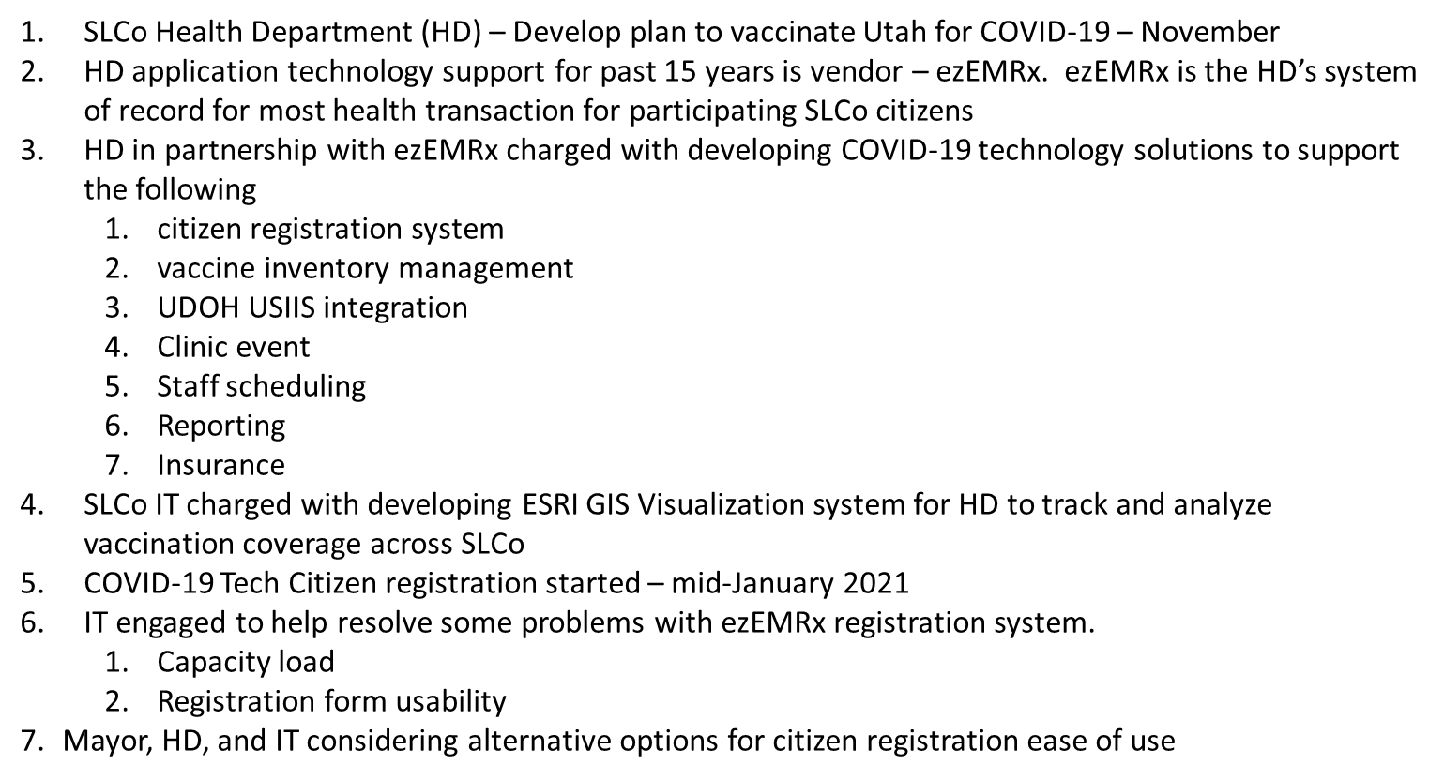
COVID Update Zach Posner

Slide 9
Review Follow – Up Items Cherie Root
TASK | RESPONSIBLE
Send Engagement Ideas for IT Governance to Zach | TAB Members
SharePoint Document Management Update | Tony Jolley
County-Wide Website Redesign | Megan Hillyard
Public Website Accessibility Standard | Mark Evans
Policy 1400, 1400-1 – Revision to Council | Cherie Root
Engage with Telecommuting Working Group | Zach Posner
Public File Uploads Standard | Mark Evans
Separate Slide
In-Process
Complete

Slide 10
County-Wide Website Redesign Megan Hillyard

Slide 11
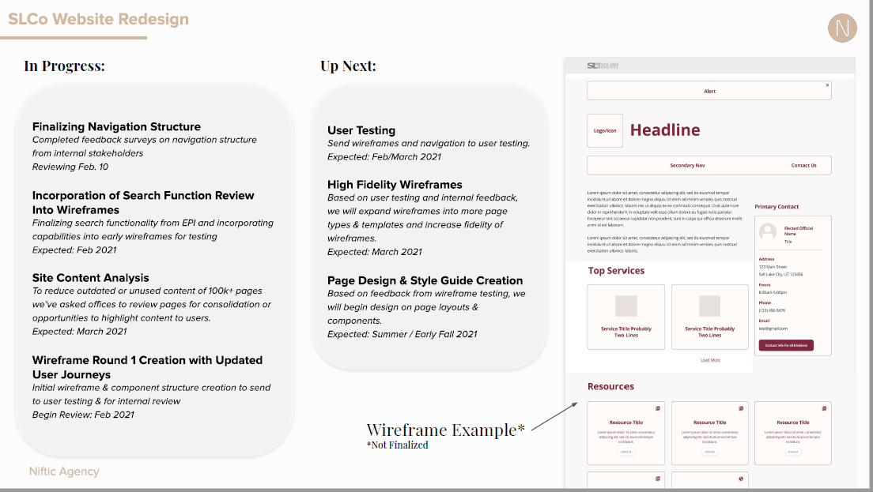

Slide 12
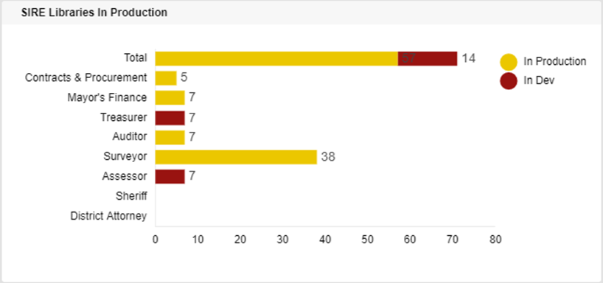
SharePoint Document Management Tony Jolley
Libraries in Production (57/71):
Treasurer – Scan Tool Deployed / Refining Batch Process Capability / User QA
Surveyor – Live in SharePoint - 3rd week of February
Future customizations to be addressed in a Phase 2
Assessor – Refining Scan Tool Requirements / ID’ing Possible Automation
Sheriff – IBM Support Ticket Opened to Assist with Content Extraction API
Notes:
The Surveyor’s office is now doing User Acceptance Testing. Once the Surveyor’s Office testing is complete, we’ll be able to move their 37 libraries to ‘In Production’.
That will be 19 + 37 = 56 in production
And 14 left (Treasurer and Assessor)
The Sheriff conversion will follow.

Slide 13
TAB Working Groups Tony Jolley
Technology Advisory Board (TAB)
Recommendations on IT Strategies, Directions, Policies & Roadmaps
Recommendations from CIO Working Groups
Request to CIO Working Groups for Inputs
Governance
Working Group (GWG)
IT Strategies & Policies
Direction Statements & County Wide Roadmaps
Governance Risk / Budget Implications
Solution and Technologies
Working Group (SWG)
SLCO Technologies & Solutions List Modifications
Technologies for Solutions
Technology & Solution Standards
Technology & Solution Roadmaps
Technology & Solutions Risk / Budget Implications
Portfolio and Project
Working Group (PWG)
Project Impact Considerations (Technology, Risk & Budget)
Project Prioritization
Project & Portfolio Standards
Recommendations on Overall Project & Portfolio Roadmaps
Recommendations on Major Project Issues (red)
Project & Portfolio Risk
Notes:
Background:
The working groups have been functioning for about 3 years
Each group’s purpose….
The group’s strength is from various dept & agencies in the County

Slide 14
TAB Working Groups
Governance Working Group (GWG)
Portfolio Working Group (PWG)
Solutions Working Group (SWG)
Name | Agency
Brian Boner | Arts & Culture
Dianne Orcutt | District Attorney
Kele Griffone | Criminal Justice
Ryan Perry | Regional Development
Shanell Beecher | Mayor’s Finance
Trevor Hebditch | Information Technology
Dina Blaes | Regional Development
Name | Agency
Brad Kendrick | Council
Dorothy Adams | Health Department
Jason Yocom | Contracts & Procurement
Phil Lanouette | Surveyor
Richard Cox | Clark Planetarium
Rod Kitchens | Mayor’s Finance
Tony Jolley | Information Technology
Tyson Kyhl | Facilities
Sharon Roux | HR
Name | Agency
Wiley Bogren | Recorder
Brandon Allgier | Information Technology
David Sperry | Sheriff
Emily LaMunyon | Surveyor
Justin Herron | Aging Services
Tyler Andrus | Assessor
Jason Motley | Arts & Culture
Cory Westergard | Behavioral Health
Notes:
- We appreciate the time & expertise from the areas around the county
The more expertise the better
Those names in blue are new to their groups this year

Slide 15
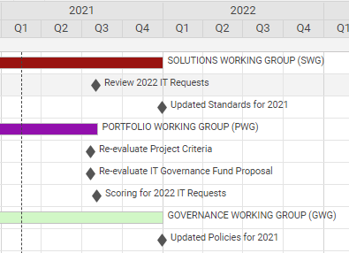
Working Groups – Milestone Chart Tony Jolley
Notes:
- We completed everything in 2020 as planned
- The Portfolio Working Group plans to re-evaluate the IT Governance Fund earlier in 2021 than we did in past years. (early in Q3 instead of Q4)

Slide 16
IT Policy & Standards Update Mark Evans
Update Countywide Policy
Update Policy 1400 Information Technology Policy and Standards
Update Policy 1400-1 Acceptable Use of Technology
IT Standards
New IT Standard – Public File Uploads
New IT Standard – Public Website Accessibility Standard
Discussion about E-Waste
Update CW policy 1100 and several IT Standards to require recycling of use IT gear through approved vendors that will destroy data on devices.

Slide 17
Technology Positions - Heather Hancock
Total IT positions in the County – 191 (This includes merit and time limited)
Total IT positions in County IT division – 102
Total IT positions in County agencies - 89
Notes:
There has been one position change out of the IT Job Family during the last quarter, where the Library reclassified a Network Specialist to a Senior Librarian. The only other changes during the quarter have been some reclassifications within the technology positions that an agency already had (Library and IT).

Slide 18
Data Governance Working Group Update Javaid Lal

Slide 19

Data Governance Working Group Update
Phase 1 – Application Inventory - In Progress
https://app.smartsheet.com/b/form/d458dcc017b3475c935adce5097634be
189 survey submission
17 agencies participated
LucidChart Survey Data Management
Application Type
Disaster Recovery (DR) Tiers
Data Categories
Privacy Standards
Application by Agencies
Data Gov Working Group SharePoint site created
Agency folders to access and update their survey data
Training Resources
Smartsheet
LucidChart

Slide 20
Data Governance Working Group Update
Phase 1 – Application Inventory - In Progress
Phase I – November 30 December 15 February 28
24 agencies were invited to participate in the survey, 17 participated.
Addressing
Aging & Adult Services
Animal Services
Assessor
Auditor
CJAC
Clark Planetarium
Contracts & Procurement
Council
Criminal Justice Services
District Attorney
Engineering & Flood Control
Facilities Services
Fleet Management
Health Department
Human Resources
Mayor’s Finance

Slide 21
Data Governance Working Group Update
Phase 1 – Application Inventory - In Progress
Phase I – November 30 December 15 February 28
24 agencies were invited to participate in the survey, 17 participated.
Public Works Ops
Recorder
Records Management & Archive
Regional Development
Solid Waste
Surveyor
Youth Services
ZAP Admin
Office of Data & Innovation
Information Technology

Slide 22
Data Governance Working Group Update
Phase II – Application Inventory
Invitation to all remaining agencies to participate in the survey.
Request for Data Coordinators
Data Coordinators Training
Administrative Services
Arts and Culture
Assessor
Auditor
Behavioral Health Services
Clerk
Community Services
Council
Council-Tax Administration
County Library
Criminal Justice Advisory Council
Criminal Justice Services
District Attorney
Emergency Services
Equestrian Park
Extension Service
Golf
Government Center Operations
Human Services
Justice Courts
Mayor Administration
Office of Regional Development
Open Space
Parks
Public Wks & Municipal Service
Public Works Engineering

Slide 23
Data Governance Working Group Update
Phase II – Application Inventory
Invitation to all remaining agencies to participate in the survey.
Request for Data Coordinators
Data Coordinators Training
Public Works Operations
Rampton Salt Palace Operations
Real Estate
Recorder
Recreation
Redevelopment Agency of SL Co
Sheriff's Office
Solid Waste Management Facility
Treasurer
UPACA Eccles Theater
Zap Fund Administration

Slide 24
Communication Items - Mayor and Council Zach Posner & Chair - New Chair & Vice-Chair - Policy 1400 & 1400-1

Slide 25
Meeting Schedule For 2021 Kristine Pepin
9:00 – 10:30 am
April 22
June 24
August 12
August 18
October 28
December 9
Notes:
August 18 will be a final vote. This is a Wed to not conflict with GIS Steering Committee.

Slide 26
Review Action Items Kristine Pepin

Slide 27
Next Meeting – 4/22/21
Thank - You
Motion and Vote to Adjourn

Slide 28
TO-DO List

