Slide 1


January 23, 2020

Slide 2
Agenda
Public Comments - Chair - 3 min
Approve Minutes from 12/12/19 Meeting - Chair - 2 min
Follow-Up Items (Informational)
  Tax Strategy Update – Phil Conder & Zach Posner – 10 min
  County-Wide Website Redesign Update – Javaid Lal – 5 min
IT Communications (Informational) – Ginger Watts – 5 min
Working Groups Milestone Chart (Discussion/Direction) - Ginger Watts – 3 min
IT Working Group Updates (Informational)
  SWG – Journal Technologies Incorporated (JTI) Discussion (Case Management) – Ginger Watts – 10 min
  SWG - Windows 7 Replacement Update – Ginger Watts – 3 min
Communication Items - Mayor & Council – Zach Posner & Chair – 1 min
2020 Meeting Schedule (Informational) - Ginger Watts – 1 min
Review Action Items – Kristine Pepin - 2 min
Next Meeting – 3/26/20 – Chair - 1 min

Slide 3
Public Comments
Chair

Slide 4
Approve Minutes
Chair

Slide 5
Review Follow-Up Items
Ginger Watts
TASK | RESPONSIBLE
Windows 7 Replacement | Solution Working Group
County-Wide Technology FTE Map | IT & HR
SharePoint Document Management Update | Lee Wilstead
Tax System on Council Agenda | Cherie Root
County-Wide Website Redesign | Javaid Lal
Voting System & Equipment Update | Jerome Battle
Journal Technologies Incorporated (JTI) SWG Discussion | Ginger Watts
Send Out 2020 TAB Meeting Invites | Kristine Pepin
In-Process
Separate Slide
Complete

Slide 6
Tax Strategy – Presentation to the Council

Slide 7
Risks
Not Doing | Doing
System failure | Resource availability
Lease on mainframe expires | Moving code proves difficult
Loss of resources through retirement | Support for modernization ceases
Skillsets to maintain are unavailable | Development completed late
County’s tax revenue stream at risk | Unable to hire mainframe programmers

Slide 8
Internal vs. Vendor Development Option
Phase 1 – off mainframe to modern system platform
Phase 2 – phase 1 plus code modernization
Phase 3 – phase 2 plus enhancements and new features
Notes:
Add phases:
1 – off mainframe
2 –
Value creation

Slide 9
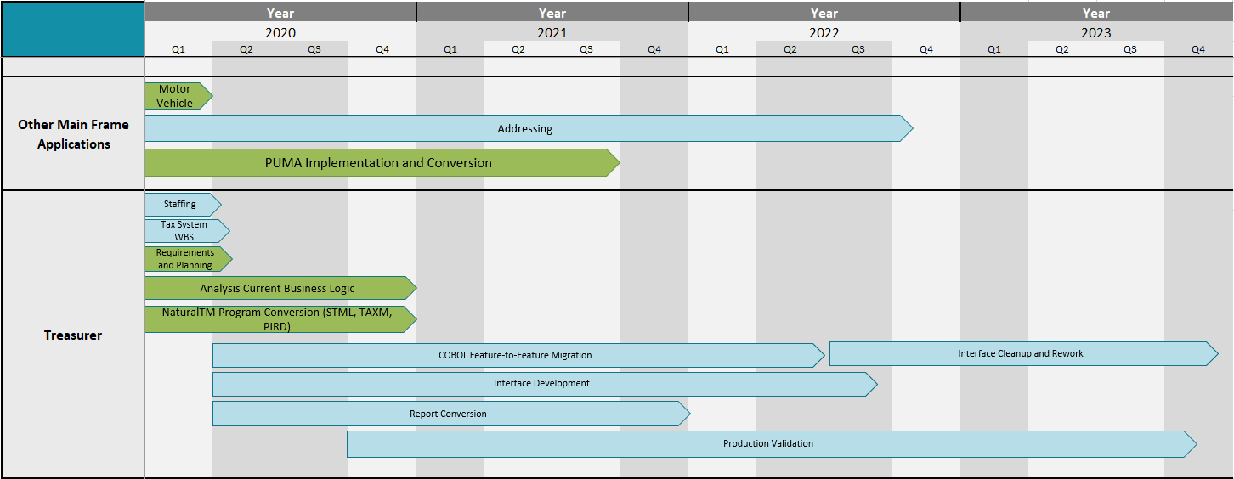
Tax Software Modernization Timeline
Not Started
In Progress
This plan gets us off the mainframe in four years

Slide 10
IT Budget
Total Inc Ask Labor
$4,116,485
Existing IT returns to
tax system operations
Notes:
Red on top, light brown on bottom
Hyperlink detail
Secondary axis for total?

Slide 11
County-Wide Website Redesign
Javaid Lal
Public Opinion Survey Update
  Survey timeline: Nov. 27, 2019 – Jan. 08, 2020
  Total Responses: 4,334
    Interrupt Survey 606
    Full Survey 3,728
Next Steps:
Review Survey findings
Build user personas for testing

Slide 12

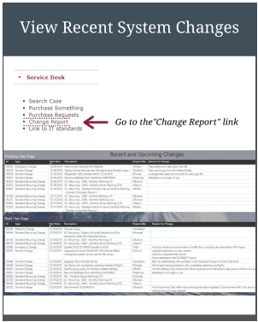
IT Communications
Ginger Watts

Slide 13
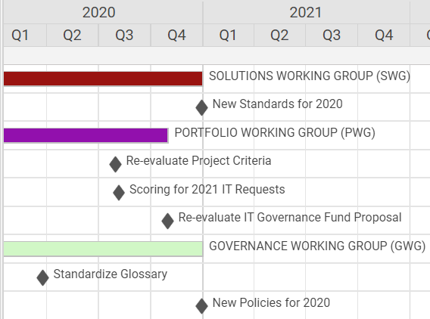
Working Groups – Milestone Chart
Ginger Watts

Slide 14
Journal Technologies (JTI) – Case Management
Ginger Watts
Meeting with Solution Working Group (SWG) and Stakeholders 1/6
Drew Gordan Presented
    Provided Demonstration of JTI Capabilities for CJS, YS & DA
    Go-Live Dates for District Attorney and Salt Lake City Police Department
    Presented Lessons Learned
Follow-up Meetings to be Scheduled to Discuss:
  How to Support JTI – Future State?
  Funding – How Should Payment Occur?

Slide 15
Windows 7 Replacement Update
Ginger Watts

Slide 16
Communication Items - Mayor and Council
Zach Posner & Chair

Slide 17
Meeting Schedule For 2020
Ginger Watts
9:00 – 10:30 a.m.
March 26th
May 28th
July 9th
August 13th – 10:00 a.m. – 11:30 a.m.
August 19th – Wednesday – 9:00 a.m. to 10:00 a.m.
October 22nd
December 10th

Slide 18
Review Action Items
Kristine Pepin

Slide 19
Thank
Next Meeting – 03/26/2020
Thank
You
You !

Slide 20
Agenda
Public Comments (Kevin) - Chair - 3 min (9:00 – 9:03)
Approve Minutes from 12/12/19 Meeting - Chair - 2 min (9:03 – 9:05)
Follow-Up Items (Informational)
  Tax Strategy Update – Phil Conder & Zach Posner – 10 min (9:05 – 9:15)
  County-Wide Website Redesign Update – Javaid Lal – 5 min (9:15 – 9:20)
IT Communications (Informational) – Ginger Watts – 5 min (9:20 – 9:25)
Working Groups Milestone Chart (Discussion/Direction) (Rashelle) - Ginger Watts – 3 min (9:25 – 9:28)
IT Working Group Updates (Informational)
  SWG – Journal Technologies Incorporated (JTI) Discussion (Case Management) – Ginger Watts – 10 min (9:28 – 9:38)
  SWG - Windows 7 Replacement Update – Ginger Watts – 3 min (9:38 – 9:41)
Communication Items - Mayor & Council – Zach Posner & Chair – 1 min (9:41 – 9:42)
2020 Meeting Schedule (Informational) - Ginger Watts – 1 min (9:42 – 9:43)
Review Action Items – Kristine Pepin - 2 min (9:43 – 9:45)
Next Meeting – 3/26/20 – Chair - 1 min (9:45 – 9:46)
Close Meeting – Need a motion, second and vote to close

Slide 21
Agenda
Public Comments (Kevin) - Chair - 3 min (9:00 – 9:03)
Approve Minutes from 12/12 Meeting - Chair - 2 min (9:03 – 9:05)
Follow-Up Items (Informational)
  SharePoint Document Management Update – Lee Wilstead – 3 min (9:05 – 9:08)
  County-Wide Website Redesign Update – Javaid Lal – 3 min (9:08 – 9:11)
  Data Governance Working Group – Javaid Lal – 5 min (9:11 – 9:16)
Budget Update (Informational) – Cherie Root – 5 min (9:16 – 9:21)
Voting System & Equipment (Informational) – Zach Posner– 5 min (9:21 – 9:26)
Working Group 2020 Governance Session(Discussion/Direction) – Zach Posner – 20 min (9:26 – 9:46)
2019 Budget Session Lessons Learned (Discussion/Direction) – Ginger Watts and Cherie Root – 15 min (9:46 – 10:01)
Working Groups Milestone Chart (Discussion/Direction) - Ginger Watts – 3 min (10:01 – 10:04)
IT Working Group Updates (Rashelle)
  GWG –
  SWG – Windows 7 Replacement Update (Informational) – Ginger Watts – 3 min (10:07 – 10:10)
Communication Items - Mayor & Council – Zach Posner & Chair – 1 min (10:10 – 10:11)
2020 Meeting Schedule (Discussion/Direction) - Ginger Watts – 1 min (10:11 – 10:12)
Review Action Items – Kristine Pepin - 2 min (10:17 – 10:19)
Next Meeting –3/26/2020 – Chair - 1 min (10:19 – 10:20)
Close Meeting – Need a motion, second and vote to close

Slide 22
TO-DO List
Cherie and Ginger to meet with HR before March meeting by 3/13
  List as HR
  List as IT
  List to meet definition
  Process to keep list updated
  TAB meeting to determine who to present and how often
Kristine to prepare Agenda for Kevin & Rashelle by 1/22.
Kristine to post approved minutes for 12/12 by 1/23.
Cherie to provide feedback on IT Procurement guidance by 1/31.
Trevor to coordinate glossary combinations 1/24.
Lee slide SIRE to SharePoint by 3/13 – Moving to 3/26 Meeting
Kristine to post agenda on public notice website by 1/21.
Kristine to make Talia and Javaid table tents by 1/22.
Jerome to Provide Clerk slides by 3/13 – Moving to 3/26 Meeting
Ginger to Update Concept Document title to Business Case and the Glossary by 1/22
Ginger to add JTI staffing and payment to SWG 2/4 agenda.
Dianne to provide Training slides by 3/13.
Ginger to email Dianne by 2/28 to remind about training slides.

