Slide 1


March 28, 2019

Slide 2
Agenda
Public Comments - Chair - 3 min
Approve Minutes from 01/24/2019 Meeting - Chair - 2 min
Follow-Up Items (Informational)
  SharePoint Update – Ginger Watts – 5 min
  Debrief of 2019 Budget Process and Scoring – Cherie Root – 5 min
  Long Distance Code Update – Cherie Root – 5 min
Website Design Update (Discussion/Direction) – Megan Hillyard & Zach Posner – 10 min
Phone System Licensing (Informational) – Corey Hess – 10 min
County Connect (Informational) – Michael Duncan – 5 min
Working Groups Milestone Chart (Discussion/Direction) - Ginger Watts – 3 min
Governance Working Group Updates
  GWG – Concept Document Glossary (Discussion/Approval) – Phil Lanouette & Trevor Hebditch – 5 min
  SWG - Windows 7 Replacement (Discussion/Direction)– Tyler Andrus & Ginger Watts – 5 min
  SWG - Offboarding Process for AD Accounts (Informational) – Mike Bailey – 5 min
  PWG - Project Review (Informational) – Ginger Watts – 3 min
  PWG – Tax Update (Informational) – Glade Jarman & Phil Conder – 15 Min
Communication Items - Mayor & Council - Zach Posner & Chair – 1 min
2019 Meeting Schedule (Informational) - Ginger Watts – 1 min
Review Action Items – Kristine Pepin - 2 min
Next Meeting – 05/23/2019 – Chair - 1 min

Slide 3
Public Comments
Chair

Slide 4
Approve Minutes
Chair

Slide 5
Review Follow-Up Items
Ginger Watts
TASK | RESPONSIBLE
1. Windows 7 Replacement | Solution Working Group
2. County Wide Technology FTE Map | IS & HR
3. SharePoint Update | Ginger Watts
4. Email Public Meetings & Ethics Training to TAB Membership | Ginger Watts
5. Debrief 2019 Budget Process and Scoring | Cherie Root
6. UFA Les Olson and Emergency Management Update | Ginger Watts
7. Invite Kevin Jacobs and Rashelle Hobbs to Working Group Meetings | Ginger Watts
8. Send Long Distance Code Implementation Information | Cherie Root
9. Inform Mayor & Council of Change in TAB Leadership | Zach Posner

Slide 6
SharePoint Electronic Document Management Solution
Ginger Watts
Contracts & Procurement department migration to SharePoint near completion
Migration planning underway with Mayor’s Finance, Treasurer and Auditor
Will incorporate “lessons learned” from Contracts & Procurement migration in follow-on migrations
Interest in SharePoint usage growing
Agency/Department | Expected Completion
Contracts & Procurement | 4/15/2019
Mayor’s Finance | Q2 2019
Treasurer | Q2 2019
Auditor | Q3 2019
Surveyor | 2019
Assessor | 2019
Recorder | TBD
Sheriff | TBD

Slide 7
2020 Budget Process Planning (Based on Debrief of 2019)
Cherie Root
Issue | Idea | Impact | Ability to Implement | Next Steps
Dates | Maintain 2018 schedule | High | High | 1. Communicate the dates
Cadence (Throughout the year; not just at budget) | IT Capital Fund Reporting cadence | High | Low | 1. IT needs to be the example 2. Communicating with the working groups 3. Fiscal Operations training (frequently)
Funding Source Buckets vs. combined priority | Better communicate the purpose of the buckets | Medium | Medium | 1. PWG discuss strategy 2. Talk with Megan then Darrin.
Scoring (weighting, forced ranking) | Add enterprise score with less weight (number of agencies/employees/impact score) Add a "Funding Ready" score? | Medium | Low | 1. Ginger to research best practices with Governance 2. PWG discussion
Customer sign off (Add to workflow) | Add to workflow in the tool | High | High | 1. Put into POB workflow
TCO consistency | Clear definitions. Make sure the templates work. | Medium | Medium | 1. Definition legend to Concept Document and TCO.
Do FTE’s need a separate process? | On-Going vs. One-Time | High | Medium | 1. HR working on IT FTE inventory
Form Entry | Poll Fiscal Managers | High | High | 1. Ginger to interview several fiscal managers at the next Fiscal Operations meeting.
TAB Leadership to Present to Mayor's Finance | Chair/Vice Chair/CIO | High | High | 1. Megan to meet with Darrin
Mayor Finance Representation at TAB Budget Meetings | Darrin and/or Rod | High | High | 1. Megan to meet with Darrin

Slide 8
Long Distance Code Update
Cherie Root

Slide 9
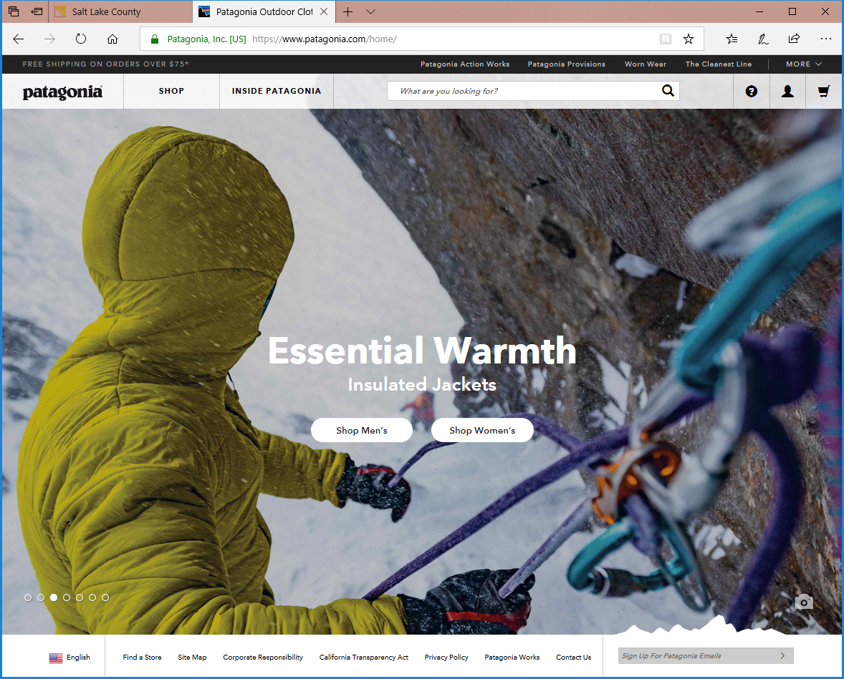
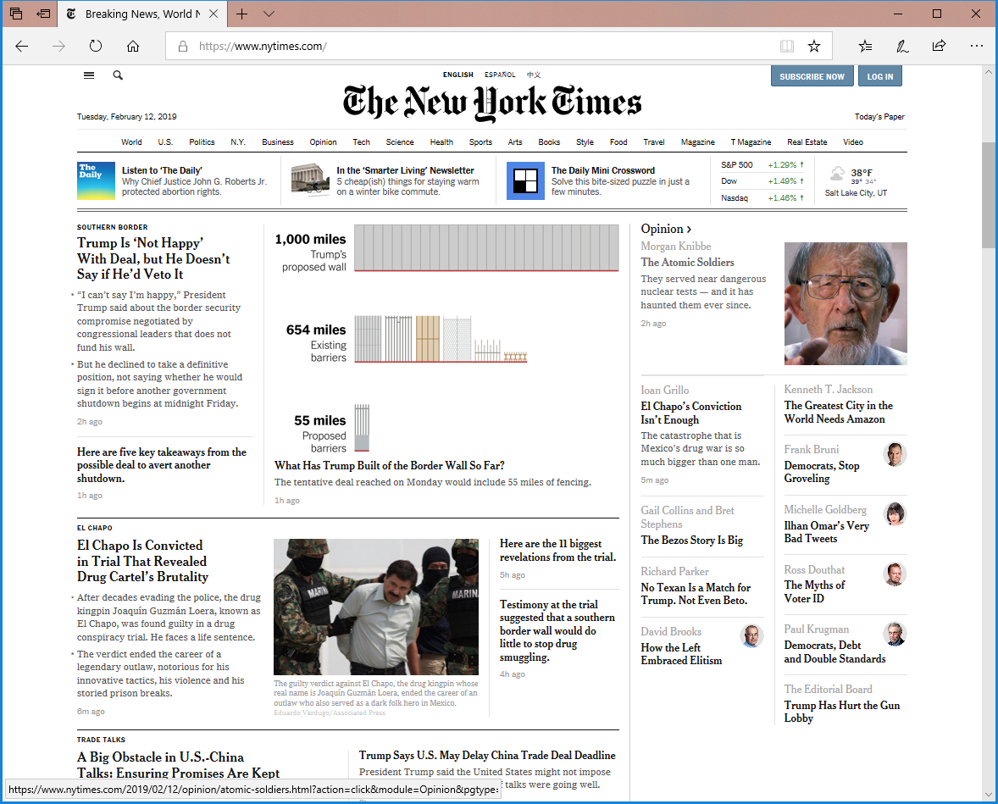
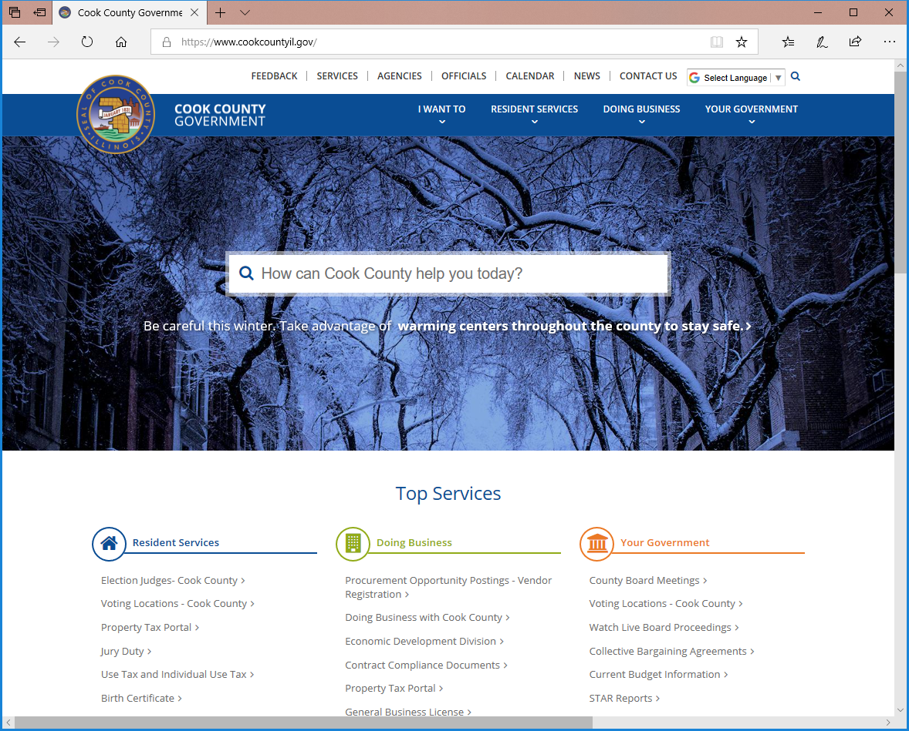
Website Design Update
Megan and Zach
Project reviewed with the Mayor
  Goals
      Connect constituents to services and information
      Use data and analytics to drive design
      Clean unified user experience that incorporates County branding

Slide 10
Website Governance
Megan / Zach
Establish a sponsor team with a representative from (keep it small)
Council
Mayor Office
Elected
Outsource the building of a brand book and wireframes
Focus groups
Learn from others
Focus on usability
User Interface, User Design
Great Search
Constituent first
Bring Data from our current website
Google Analytics
Hotjar

Slide 11
Phone System Licensing
Corey Hess
Moving to an Enterprise Licensing Model
These benefits are at the same cost the County is currently paying under the current Cisco Licensing Model
Puts the County on a five year maintenance agreement that protects us from a 14% increase every three years
Expands our capabilities to all users, including:
  Emergency Responder
  SRST (Survivable Remote Site Telephony)
  WebEx Meetings & WebEx Teams

Slide 12

Phone System Licensing
Corey Hess
Cisco “FLEX” Enterprise Agreement Model
Calling
Meetings + Teams
Webex Calling/Broadsoft
Webex Meetings
Webex Teams
Hosted (HCS)
Cisco Meeting Server
Cisco Unified Communications Manager

Slide 13

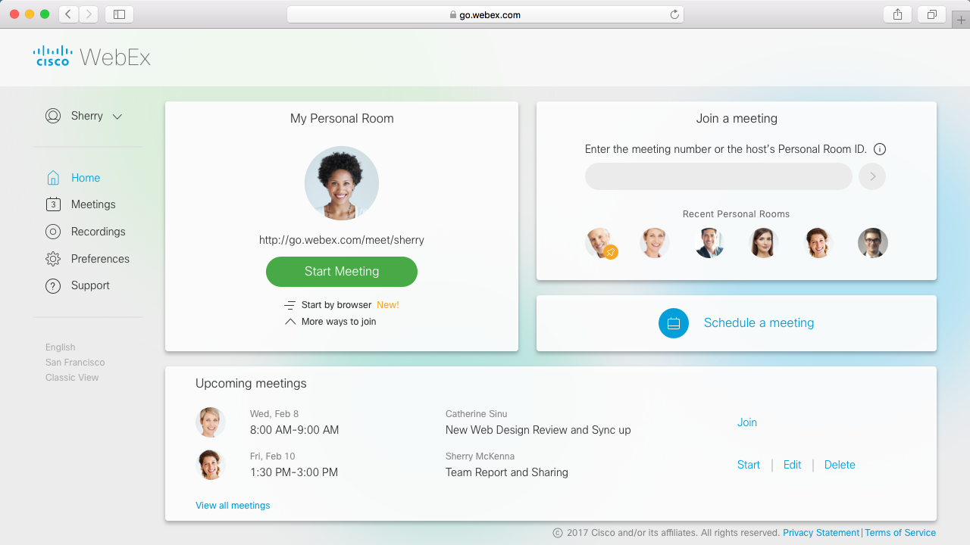
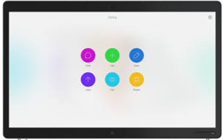

Phone System Licensing
Corey Hess
Standardized Conferencing using Webex
Cloud-Based Meetings Experience supporting on-prem high quality video endpoints and interactive team board, standard desktop phones, computers, browsers, mobile devices and third-party clients
Desk Phone
Tablet
Mobile Phone
Computer
Webex
Collaboration
Cloud
Desktop Video
Webex Meetings
Small/Medium Conference
Room Video
Interactive Team Board
Large Conference Room Video

Slide 14
Phone System Licensing
Corey Hess

Slide 15
County Connect Update
Michael Duncan
Internal soft launch October of 2018
Purpose is to collect reports and information from citizens and organizations regarding:
  Road issues
  Animal Services
  Parks and Recreation
  Feedback for the Mayor
  Other
ESRI Mobile Technology integrated with Point of Business (POB)
Spatial representation of each report based on location
Future integration with internal & external business systems
Available via AppStore and Google Play Store

Slide 16
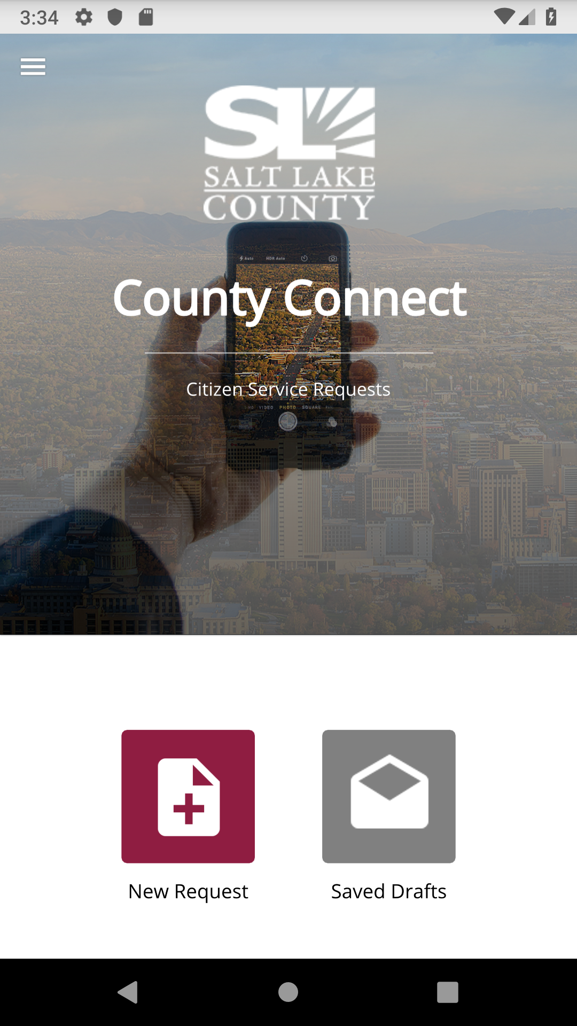
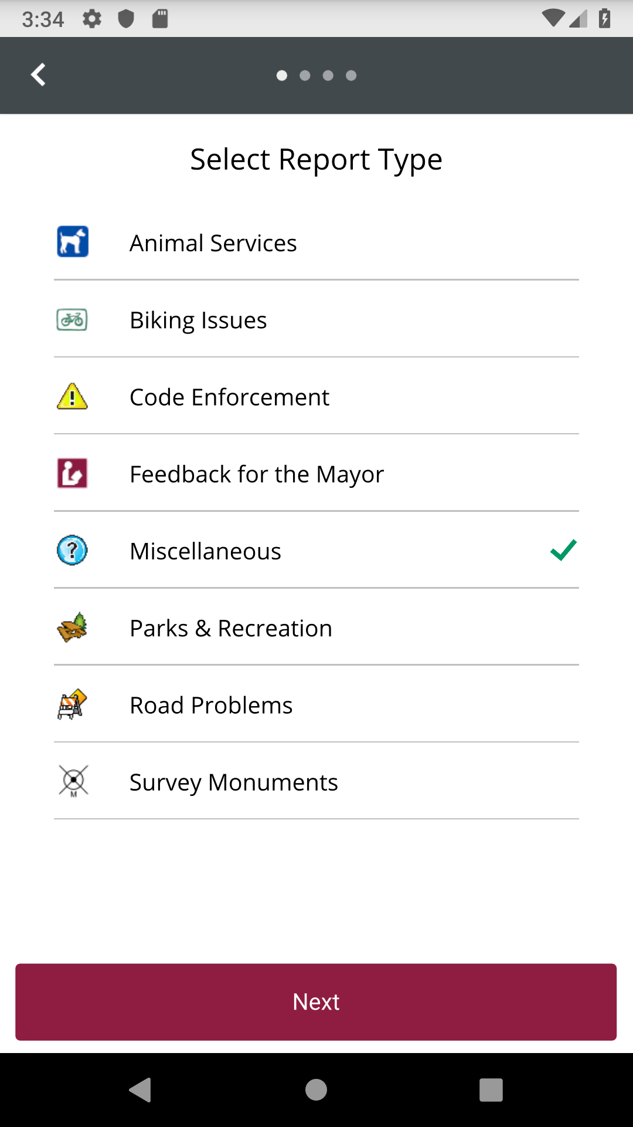
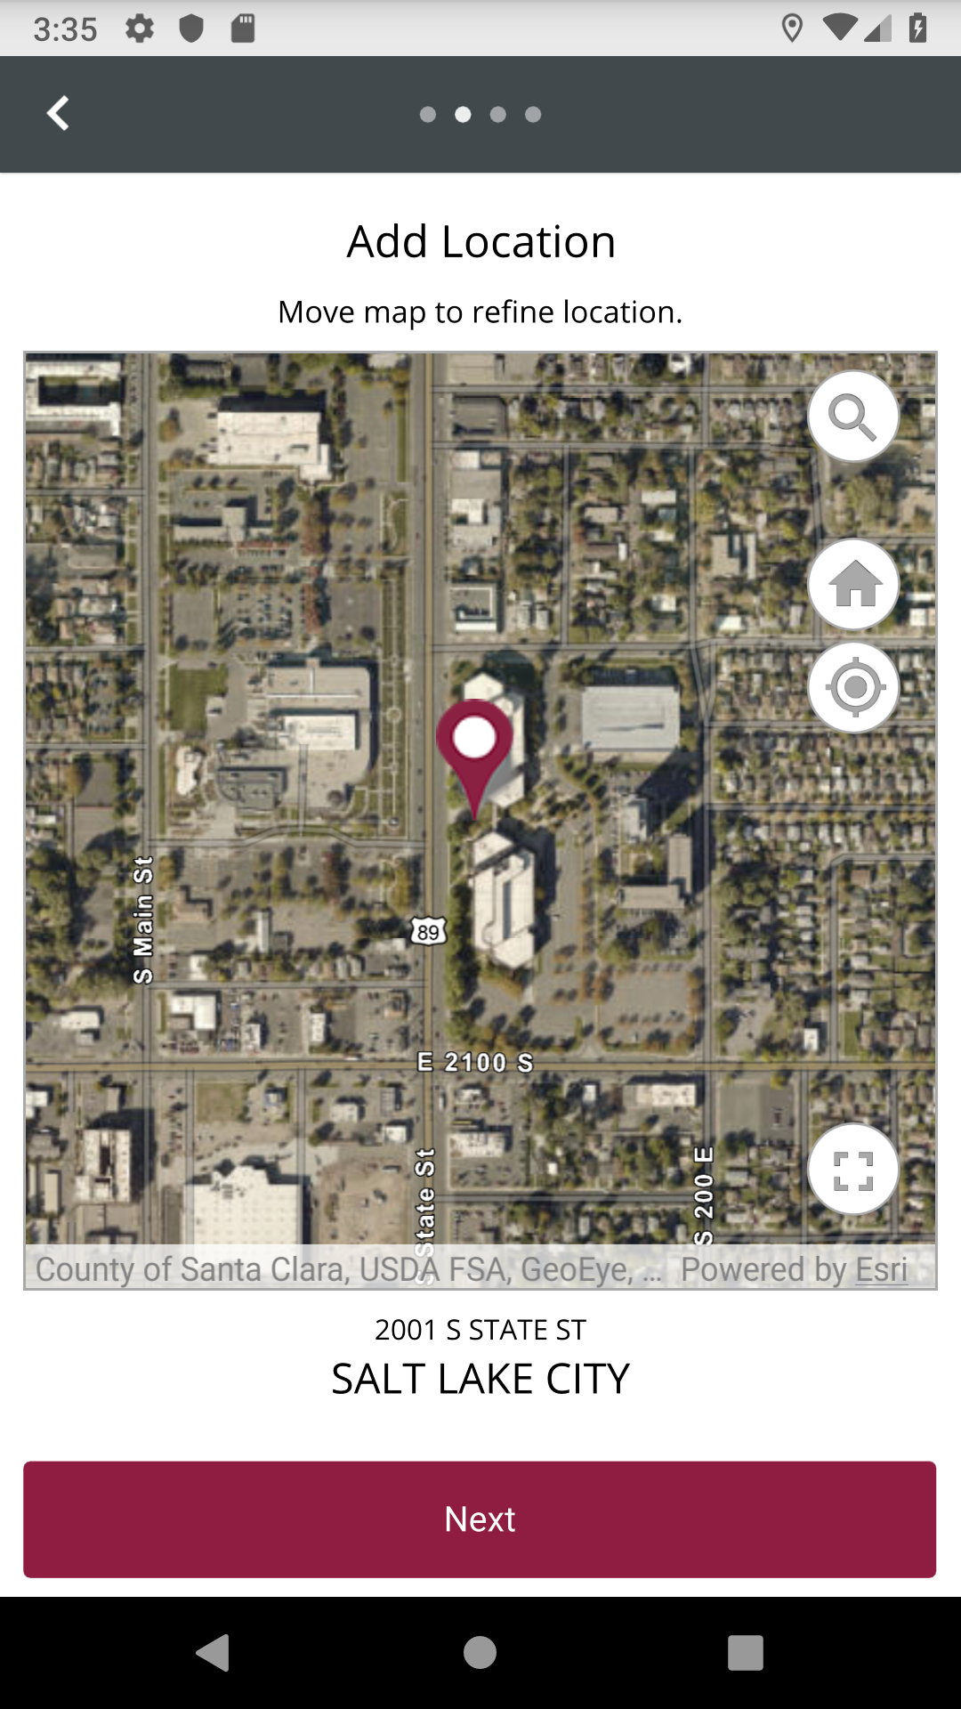
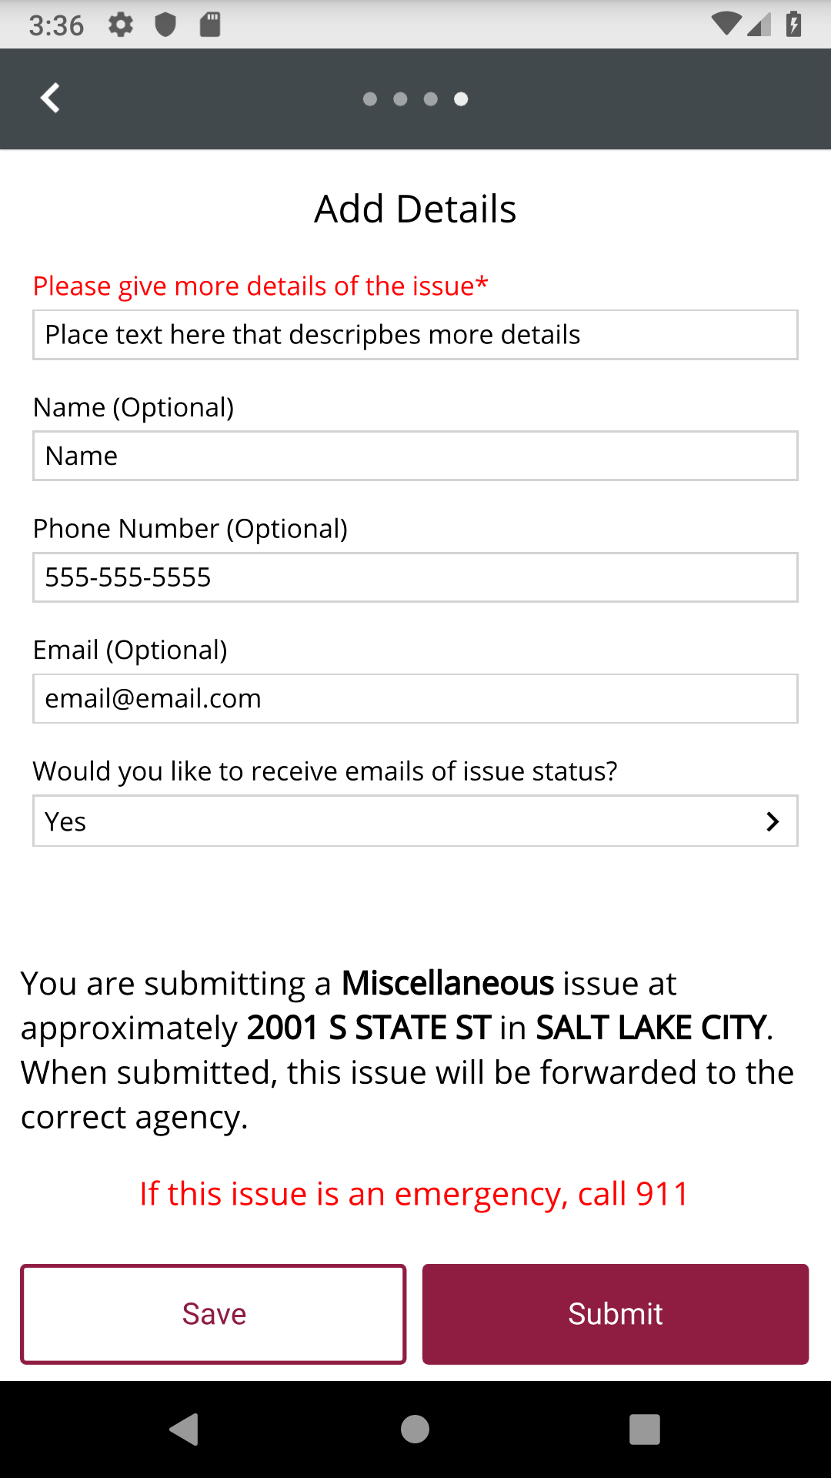
County Connect Update
Michael Duncan

Slide 17
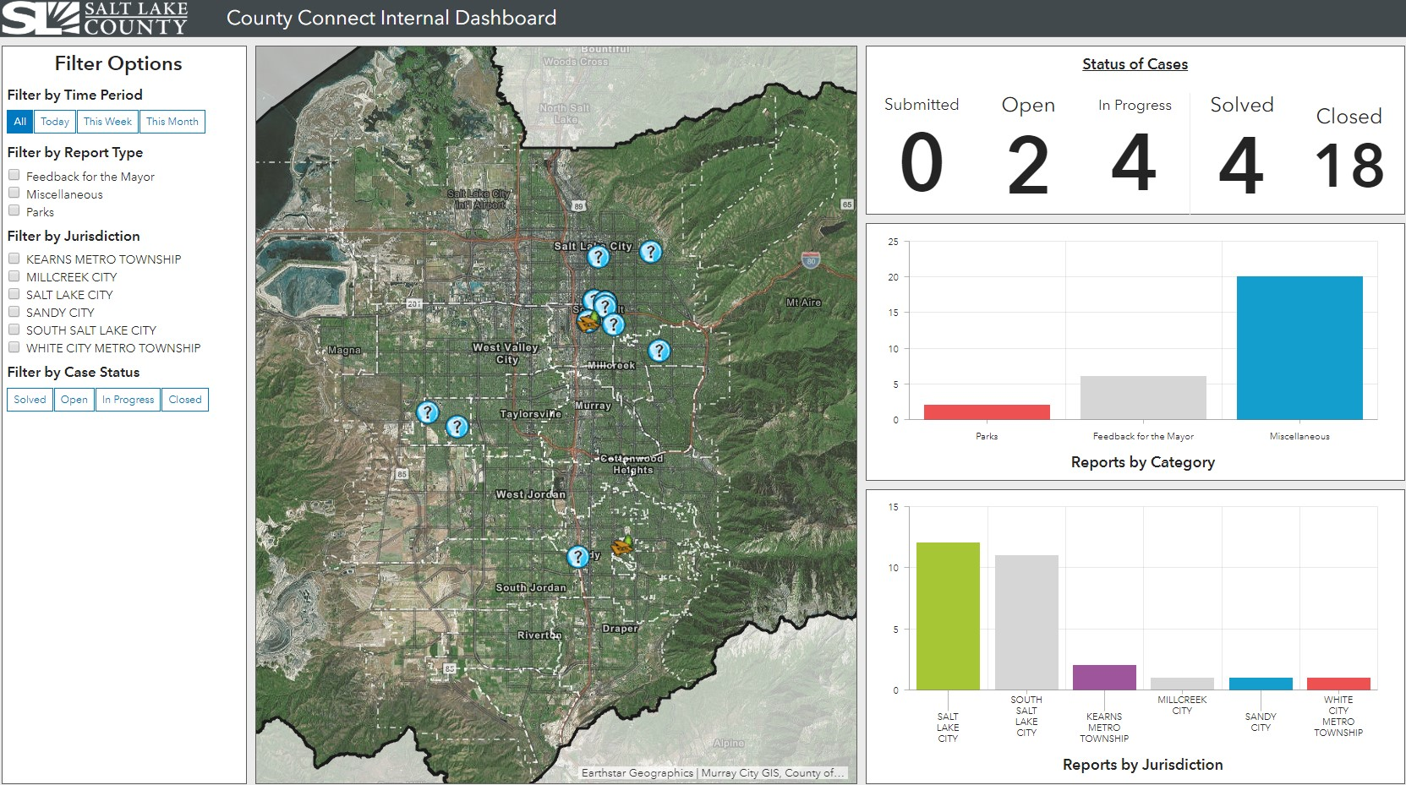
County Connect Update
Michael Duncan

Slide 18
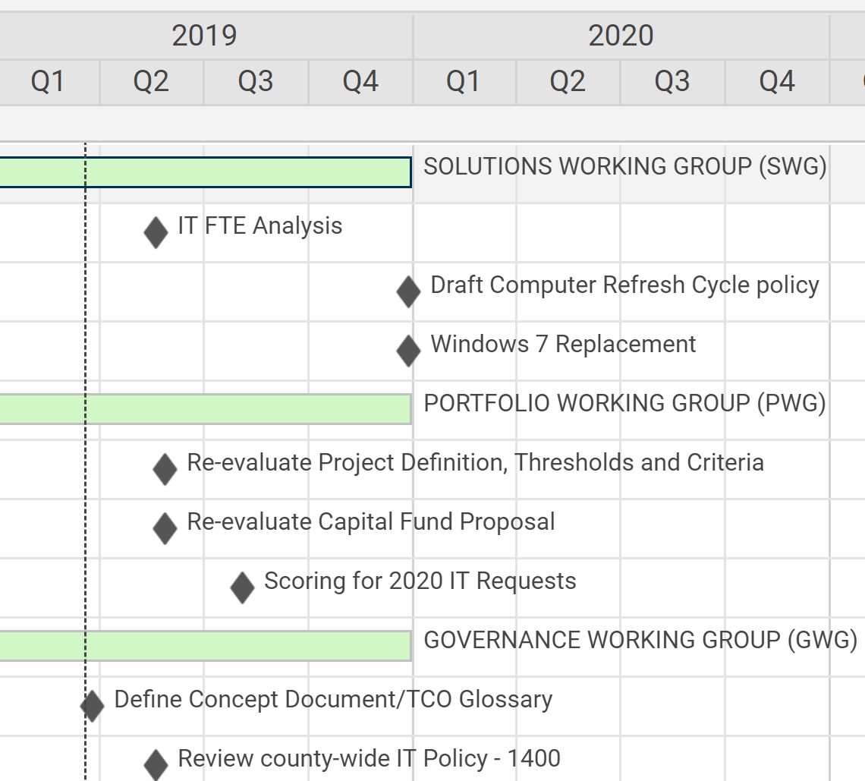
Working Groups – Milestone Chart
Ginger Watts

Slide 19
Governance Working Group
Concept Document Glossary
Phil Lanouette & Trevor Hebditch

Slide 20
Solution Working Group
Windows 7 Replacement
Tyler Andrus & Ginger Watts
Windows 7 will no longer be supported in January 2020
Spreadsheets asking for a preliminary plan sent to Business Technology Partner (BTP) Contacts
Due date of 2/28/2019
37 Agencies have provided preliminary plans
Waiting for 8 agencies to provide information
Notes:
Waiting for data from: Clerk, Community Resources, Community Services, Human Services, Mayors Operations, Printing, Facilities, and Human Resources.

Slide 21
Offboarding Process for AD Accounts
Mike Bailey

Slide 22
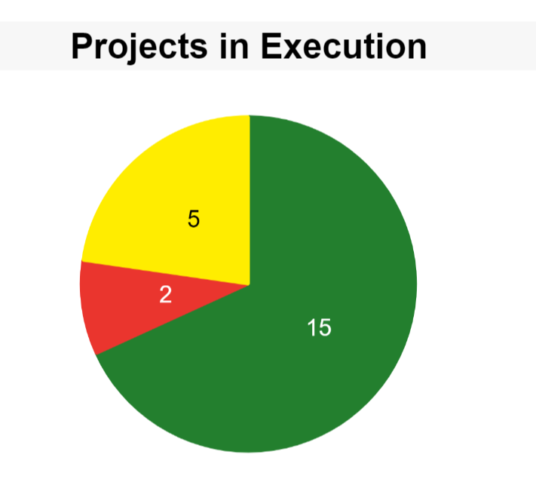
Portfolio Working Group
Project Review
Ginger Watts
Reviewed the Red and Yellow Projects
Update Provided on Tax System
Link to Pie Chart

Slide 23
Tax System Update
Glade Jarman & Phil Conder

Slide 24
Tax System Modernization
History
Progress
Current Situation
Timeline
Constraints
Successes
Sponsors

Slide 25
History
October 2017 – March 2018
  Testing
  Performance issues
March 2018
  Initial evaluation of Progressive Utah Mass Appraisal (PUMA)
April 2018
  Separation from Harris
June 2018 – September 2018
  Gap discovery and gap analysis of PUMA
  Research path forward for other agencies

Slide 26
Progress
PUMA
  SLCo Architecture Committee performs code review
  Accepted as Assessor’s preferred path forward
Request for Information (RFI)
  16 responses
  Varied ideas are examined
Process Mapping & Documentation
  More complete documentation of agencies’ processes

Slide 27
Research Conclusion
SLCo Architecture Committee
  Reviewed pros and cons of each of the RFI submissions
  Weighed benefits and risks of all approaches
  Determined that a feature-to-feature approach would leave SLCo in the best position

Slide 28
Current Situation
PUMA
  Accepted as Assessor’s future appraisal system
  Multi-County Appraisal Trust (MCAT) number of developers limited
  Not a solution for other agencies
Billing, Collections, Workflow, Appeals and Relief
  Need to determine best path forward
  Researching solutions both in-house and external

Slide 29
Timeline
Q4
2018
Q1
2019
Q2
2019
Q3
2019
Q4
2019
Q1
2020
Q2
2020
Roll
Turn
Roll
Turn
Planning and
Assessment
NaturalTM Code
Conversion
RFP
In-House or
External Decision
Install
Servers
Inventory Discovery
and Verification
Test Script Development
& Conversion
Kickoff and Assessment
July 2019

Slide 30
Constraints
Completion of Request for Proposal (RFP)
  Awaiting security section
  Final review and submission
Determine best path forward
Develop timeline for future and project plan
Resource issues
Size of the tax system
Unique statutes and operating procedures require Commercial Off-The-Shelf (COTS) packages to be heavily modified
Extremely labor intensive
  Current system requires specialized programmers to maintain code
  New system rewrite is estimated to take 13 FTE spread over 20 people for 3-4 yrs.

Slide 31
Successes
Product Owner assigned to the project

Slide 32
SPONSORS
  Assessor’s Office – Kevin Jacobs
  Treasurer’s Office – K. Wayne Cushing
  Auditor’s Office – Scott Tingley
  Tax Administration – Brad Neff
  Information Services – Zachary Posner

Slide 33
Communication Items - Mayor and Council
Zach Posner & Chair

Slide 34
Meeting Schedule For 2019
Ginger Watts
2019 – Fourth Thursday – 9:00 – 10:30 a.m.
May 23
July 11
August 22
September 26
November TBD (11/14?)
December TBD

Slide 35
Action Items
Review new action items – Kristine Pepin

Slide 36
Thank
Next Meeting – 05/23/2019
Thank
You
You !

