Slide 1


May 28, 2020

Slide 2
Remote Meeting Instructions
Phil Martinez
This meeting is being recorded.
If you want to make a comment, please raise your hand or put your comment in the chat.
Any comment in the chat will be addressed for the recording.
If you are joining via phone, you will be muted initially. During Public Comments, your phone will be unmuted and you will be able to make a comment if desired.

Slide 3
Agenda
Public Comments - Chair - 3 min
Approve Minutes from 1/23/20 Meeting - Chair - 2 min
Open & Public Meetings Act Training – Dianne Orcutt – 10 min
Follow-Up Items:
  SharePoint Document Management Update (Informational) – Lee Wilstead – 5 min
  County-Wide Website Redesign Update (Informational) – Megan Hillyard– 5 min
  Data Working Group Update (Informational) – Javaid Lal, Beth Graham, & Jeff Eason– 10 min
  Voting System & Equipment Update (Discussion/Approval) – Pam Tueller & Lannie Chapman - 10 min
IT Lessons Learned – COVID (Informational) – Zach Posner – 10 min
Budget Update – (Informational) – Cherie Root – 5 min
Policy and Standards (Discussion/Approval) – Mark Evans – 5 min
  Policy 1400-7 – Payment Card Industry Data Security Standard Policy
  IT Standards
    Secure Windows Device Configuration
    Secure Network Configuration
Working Groups Milestone Chart (Discussion/Direction) – Zach Posner – 3 min
IT Working Group Updates
  SWG - Windows 7 Replacement Update (Informational) – Brandon Allgier - 5 min
  GWG – IT Glossary Update (Discussion/Approval) – Trevor Hebditch – 3 min
Communication Items - Mayor & Council – Zach Posner & Chair – 1 min
2020 Meeting Schedule (Informational) -– 1 min
Review Action Items – Kristine Pepin - 2 min
Next Meeting – 7/09/20 – Chair - 1 min

Slide 4
Public Comments
Chair

Slide 5
Approve Minutes
Chair
Motion and Roll Call Vote

Slide 6
Open & Public Meetings Act Training
Dianne Orcutt
Link to Open Meetings Training

Slide 7
Review Follow-Up Items
Cherie Root
TASK | RESPONSIBLE
Windows 7 Replacement | Solution Working Group
County-Wide Technology FTE Map | IT & HR
SharePoint Document Management Update | Lee Wilstead
County-Wide Website Redesign | Javaid Lal
Voting System & Equipment Update | Jerome Battle
Journal Technologies Incorporated (JTI) SWG Discussion | Tyler Andrus & Brandon Allgier
Data Working Group Update | Javaid Lal
In-Process
Separate Slide
Complete

Slide 8
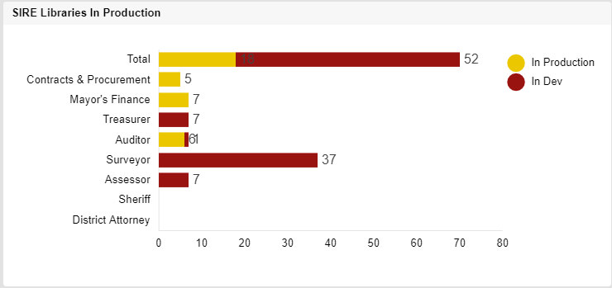
SharePoint Document Management
Lee Wilstead
Libraries in Production – 18 of 70 (26%)

Slide 9
SharePoint Document Management
Lee Wilstead
Libraries in Production – 18 of 70 (26%)
Search feature deployed – March 4, 2020
    User Acceptance Testing with Treasurer / Auditor / Surveyor
Scan feature to be deployed – NLT May 31, 2020
Custom Scan features to be developed
    Bar Code
    Zone Scan
    Streamlining of Online Tax Appeal
  Weekly Sponsor Update Meetings

Slide 10
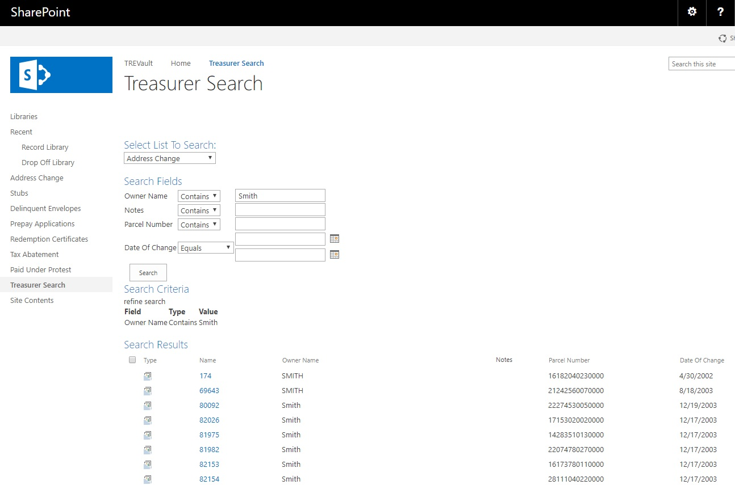

Slide 11
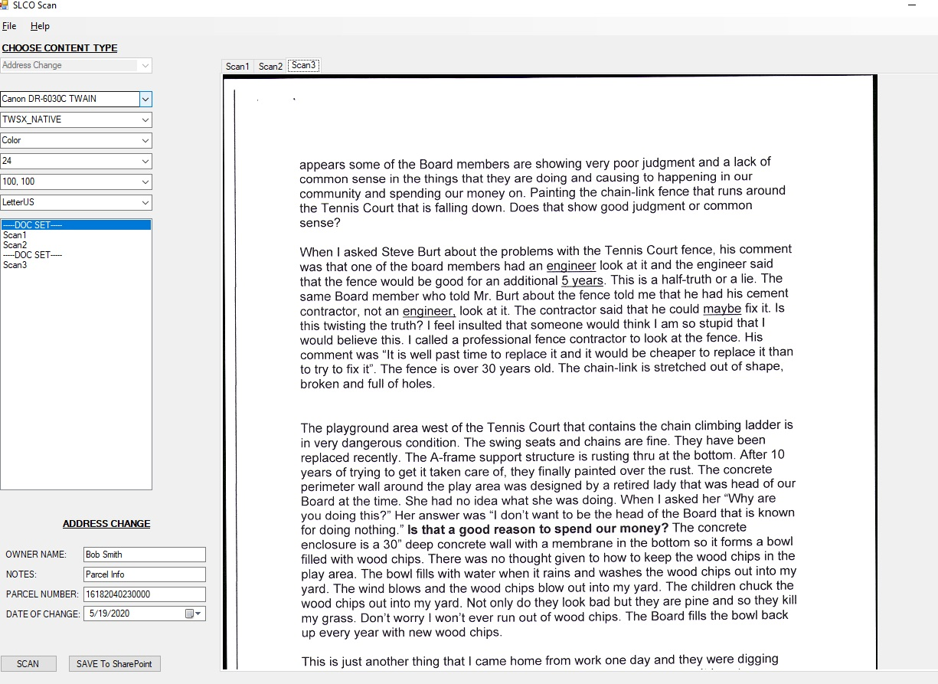

Slide 12
County-Wide Website Redesign
Megan Hillyard

Slide 13
Data Working Group Update
Javaid Lal, Beth Graham, & Jeff Eason

Slide 14
Data Governance Working Group Update

Slide 15
Data Governance Working Group Update
Monthly Meetings
  Data Security
  Risk Management
  Enterprise Data Architecture
  Physical Data Integrity
  WebEx
Development of Value Data Governance Value Propositions

Slide 16
Value Propositions
Data as a Strategic Asset
Data Catalog/Library
Data Security
Data Integrity
Data Accessibility & Sharing
Data Risk & Liability

Slide 17

Value Propositions
Data as a Strategic Asset
Definition: Data and content of all types are assets with all the characteristics of any other asset. Therefore, they should be managed, secured, and accounted for as other material or financial assets.
Value: Advancing the understanding of data as a strategic asset will allow the implementation of and adherence to effective data governance policies and processes.
Notes:
E.g. linking mental health and criminal data may provide insight into better ways to reduce crimes by providing better treatment programs.

Slide 18

Value Propositions
Data Catalog / Library
Definition: A detailed and comprehensive data inventory that makes data appropriately discoverable.
Value: Knowing what information is available and how it can be related allows for new insights, knowledge, and wisdom.
Notes:
Detailed and comprehensive data inventory that makes its data appropriately discoverable and accessible. Knowing what information is available and how it can be related, then allows for new insights, knowledge and wisdom can to be found.
Data inventory
Available
Missing
Innovation
Multisector impact

Slide 19

Value Propositions
Data Security
Definition: Data Security means protecting digital data from unauthorized access and unwanted actions.
Value: Knowing what data is restricted or protected allows implementation of proper security measures to protect the privacy and confidentiality of the data.

Slide 20

Value Propositions
Data Integrity
Definition: Data integrity is the overall accuracy, completeness, relevance, timeliness, and consistency of data and metadata.
Value: Maintaining data integrity allows users to trust data and generate reliable insights. Strong data integrity guidelines support validity, stability, searchability, and recoverability.
Notes:
The relevance, meaning, accuracy and life cycle of data and content can affect the performance…. financial status of an organization

Slide 21

Value Propositions
Data Accessibility & Sharing
Definition: Data access is the on-demand, authorized ability to retrieve, modify, copy, or move data from IT systems based on organizational roles or responsibilities. Data sharing means sending data, receiving data, or both to advance shared objectives according to certain terms & conditions.
Value: Proper data access and ability to share with internal and external partners allows County agencies to leverage the power of data to advance greater public good.
Notes:
Documented and user-friendly process to expedite the (lawful and appropriate) sharing of data--including protected data--both cross-departmentally within the local government and with trusted outside partners.

Slide 22

Value Propositions
Data Risk & Liability
Definition: The risks in information means there is a financial liability inherent in all data or content that is based on regulatory and ethical misuse or mismanagement.
Value: Recognizing risks and liability associated with data will promote appropriate measures for data collection, retention, disposal and security to protect county from litigation and malicious ransomware attacks.
Notes:
. Knowing what data to gather, how to protect it, how to access it, and when to destroy it removes uncertainty by opening appropriate doors and pathways to progress that are both efficient and safe.
Protecting county data reduces possible cost of litigation and supports being a good steward of public data from unwanted uses and harm
Recognizing risk and liability associated with data will promote appropriate measures for data collection, retention, disposal and security to protect county from litigation and malicious ransomware attacks.
Knowing what we have will allow(s) us to dispose (of) the data in a timely fashion, freeing up storage space and security resources, speeding up the computing process, and limiting the burden for responding to litigation and GRAMA requests.

Slide 23
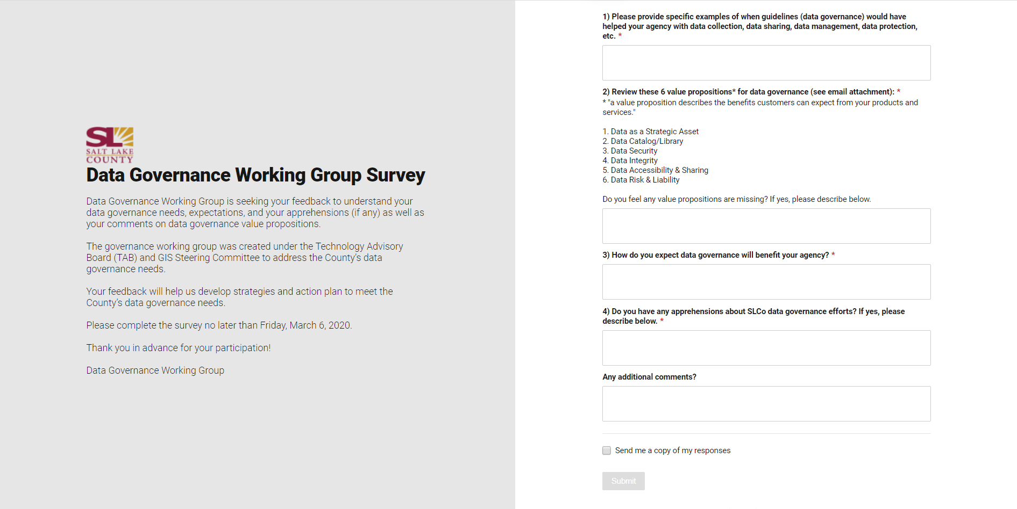
Data Gov Working Group Survey
Notes:
Data Gov Working Group
TAB Working Groups
ITPG
Data Collaboration Forum
GIS Users Group
BI User Group

Slide 24
SD-HIVE:
Social Determinants of Health
Integrated Virtual Exchange
Unlocking the value of data sharing to save lives
Notes:
Beth

Slide 25






Project: Develop an integrated data infrastructure to detect emerging drug threats and save lives
Notes:
Objectives
Explain how grant plan has changed as we have learned more about our needs/requirements
Introduce Opioid data bank as pilot to develop data governance policies and processes
Emphasize the data governance value propositions specific to this project
Communicate value of Opioid DB solutions for other County priorities (?)

Slide 26






Two grants with shared objectives support the project
Grant | Time | Outputs
Robert Wood Johnson Foundation (philanthropic) | 6 months | Data bank Master Person Index (MPI)
Bureau of Justice Assistance (federal) | 2 years | Interface for internal + external partners to upload and export data from MPI and data bank Query interface for analysis
Share + link data
Analyze data
Generate insights
Inform policy + programs
Save lives
Notes:
Goal: save lives with real-time, multi-sector data
Who we are (Beth & Jeff)
2 grants: one 6 months, the other 2 years, but they build on each other
First 6 months: understand what’s available and what we could work on. Now we better understand what our community needs. Learned that if we can share data more readily, we can support interventions in the community.
Now: ready to take action, identified this data bank as a top priority to achieve our goal and excited to move forward with IT
[See table we created for IT and pull out key points (simplify for slide; use icons)]
What we mean by “data bank”
Place for multiple partners to upload and access relevant data
Master Person Index linking individuals across these data sources
Strong protections to comply with HIPPA, 42 CFR, and other requirements

Slide 27
SD-HIVE Project Partners
SLCo Health Dept.*
Utah Dept. of Health
SLCo Criminal Justice Services
Criminal Justice Advisory Council
SLCo Dept. of Human Services*
SLCo Behavioral Health Services
Healthcare Providers
Community Partners
SLCo Sheriff
* Project leads
Notes:
Jeff: Partners for the opioid grants (share data, analyze data, improve programs to save lives)
County Health Department & Human Services lead
CJS, CJAC, BH, DA, Sheriff’s Office, Mayor’s Office
In discussions with UofU, IHC, UDOH (incl. EMS), UDHS, who are open to sharing data with the proper controls/protections → need a robust data governance structure!

Slide 28






SD-HIVE exemplifies the need for
and value of data governance
Data as a strategic asset | Data availability | Data security | Data sharing | Data standards & policies | Data disposal
Notes:
Partnering with data governance working group to get those controls in place
Creating and testing data gov processes as we go → pilot project for the data gov group
Value proposition of data gov specific to opioid response (how this saves lives)
Overlap with criminal justice, behavioral health, and public health
Value proposition for the County (creating tools and templates others could use for data gov)

Slide 29
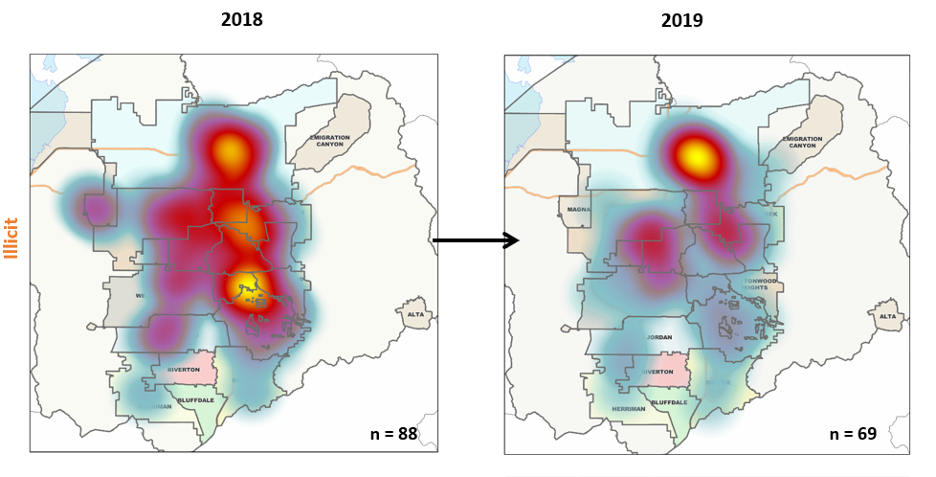
SD-HIVE will include spatial data
Notes:
Spatial data will be part of the data bank
Potential applications of spatial data:
Pull examples from other public health topics or other states’ opioid responses
Cluster detection of opioid overdose deaths
Geo hotspots

Slide 30
Questions?
Beth Graham
Human Services
egraham@slco.org
385-468-6702
Jeffrey Eason
SLCo Health Department
jeason@slco.org
385-468-4066
Notes:
Invitation to GIS folks to help if they are interested (sales pitch)

Slide 31
Next Steps & Action Items
Each agency identifies and designates Data Coordinators
Approval Requested
Data Gov will provide relevant training

Slide 32
Voting System & Election Equipment
- Pam Tueller & Lannie Chapman

Slide 33
Providers for Election Equipment & System
U.S. Election Assistance Commission (EAC) Testing and Certification Program – the process of maintaining the reliability and security of the voting systems used in our nation’s elections
EAC’s Certified Systems:
  Premier Election Solutions , Inc.(formerly Diebold)
  Dominion Voting System Corp
  Clear Ballot Group, Inc.
  MicroVote General Corp.
  Election Systems and Software
  Unisyn Voting Solution
  Hart InterCivic, Inc.

Slide 34

State of Utah’s Election Environment
Selected Election System & Software (ES&S) as their solution via RFP process in 2017
Other counties in the state different needs and population size
Notes:
demonstrate that their needs are different

Slide 35
Salt Lake County Election Division Prefers
Dominion
Functionalities
Purchase and Maintenance Costs
Similar to current election equipment
  Touch screen
  Paper trail
Provisionals are processed/ tabulated the same way as normal ballots
  Provisional use touch screens and also have paper trail
 | ES & S | Dominion
Purchase Cost | $6,335,974 | $4,256,525
TSX Trade In | (85,000)
State Funding | (1,510,940)
Discount |  | (1,265,550)
Total Purchase Cost | $4,740,034 | $2,990,975
8 Yrs. Maintenance Contracts | $1,328,510 | $1,596,554
Total Cost Over 8 Years | $6,068,544 | $4,587,529

Slide 36
County IT Reviewed Dominion and ES&S
DOMINION
ES&S
Meets security and technical concerns
Meets security and technical concern Concerns on different treatment of provisional voting from typical voting

Slide 37

Place Order & Sign Contract
Expect Delivery - December 2020
Receive and Test Equipment
Update Election Procedures
Use in 2021 Municipal Elections
Implementation Plan
Motion and Roll Call Vote

Slide 38
IT – COVID-19 Lessons Learned
Zach Posner
Self Assessment
We adapted
Customer satisfaction remained high
Need for better COOP plans
Drive to move to laptops in IT paid off
Policy
IT has an existing WFH (Work From Home) Policy
We recommend agencies adopt their own
IT will require laptops go home with staff nightly
Adopt a preference for SAAS and cloud providers via standards
Tools
Web-based collaboration tools are essential
Migrate to SAAS where possible (as part of refresh)
Pre-negotiate disaster planning with key vendors
Implement Video Suites as a standard for agency conference rooms
Morale
Maintain a sense of connectedness
Be flexible as managers, objectives vs hours
Incorporate social activities (online happy hours)

Slide 39
Budget Update
Cherie Root
Division | Short Description | Total Expenses
Information Technology | Vacant Business Technology Partner Position (Grade 19T) 10 months | (140,274)
Information Technology | Vacant Senior Business Analyst Position (Grade 17T) 12 months | (139,031)
Information Technology | Vacant Time Limited Systems Analyst Position (Grade 16T) 12 months - This would force a delay in the Tax System Redesign | (119,402)
Information Technology | Vacant QA Senior Engineer Position (Grade 16T) 12 months | (119,402)
Information Technology | Vacant GIS Analyst Position (Grade 16T) 12 months | (119,402)
Information Technology | Education & Training Serv/Supp - limits certifications and new technology training opportunities | (50,000)
Information Technology | Meals & Refreshments | (1,000)
Information Technology | Subscriptions & Memberships - Info Tech - Reduced ability to research best practices. | (40,000)
Information Technology | OFFICE FURN, EQUIP,SOFTWR: Sire to SharePoint Capital Budget - Any new technologies requiring specialized training. | (383,255)
Information Technology | Other Professional Fees - Knowledge Services - Would be unable to fund all of the current contractors. | (75,000)
Information Technology | TIP - Infrastructure Filer Growth - To accommodate 2 yrs of new filer growth without adding capacity, we would have to delete the oldest xx years worth of unopened data. | (40,000)
Information Technology | Software Subscription - Lucid Chart - Have to revert back to Visio and renewals of current Visio licenses plus, some additional licenses of Visio, will need to be purchased in November. (This does not account for any increase in Visio cost or decrease in usage if we only renew those that already have Visio licenses before we went to Lucid) | (4,874)
Information Technology | TIP - Infrastructure Server Refresh - Because of 2019 purchases made in anticipation to the data center move, our current hardware should be able to accommodate 2 yrs of standard server growth. Any unforeseen large server deployment projects would be non-standard server growth. This is part of what was purchased with 2019 under-expend. | (84,620)
Information Technology | Additional Reduction: Training and Travel Budget. Limits employee IT certifications and training options | (50,000)
Information Technology | Software Subscription - Adobe ETLA reduction, if possible - Limit the creative cloud to 25 users under contract and others have to buy licenses as needed but at a reduce cost ($700/user/yr approx.) | (40,000)
Information Technology | Other Professional Fees - Security Risk Assessment - The Information Technology Division was given an on-going budget adjustment by the County Council in 2015. The Council allocated $75,000.00 t to provide for an independent review of the County's information security program. The review was to be completed on an annual basis. I new 5-year contract was established with VLSM to provide this review. The IT Security Team is funded for 2020 from money expended in 2019. | (75,000)
Information Technology | Other Professional Fees - Sierra-Cedar Contract Modified, not eliminated - We can change the contract with Sierra Cedar to be on an hourly basis instead of set monthly fee. We are estimating we will use 1/2 the total cost of the contract. This keeps our relationship in place, keeps our systems updated, critical security patches applied in a timely manner, yearly tax & 1099 patches, Oracle provided bug fixes and help debugging system issues. | (131,400)
Information Technology | Maintenance Software - SQL Server Database Monitoring - The DBA team would no longer be able to monitor any SQL Server databases. We would not know of critical downtime issues and If there are errors or problems with any data systems such as OMS, Peoplesoft, BRASS, Prognose, POB, etc. These are critical databases spread across all agencies. The only way we would know if there are issues would be when the customer, agency or system owner calls. We would also not be able to gather any telemetry to diagnose issues. | (32,000)
Information Technology | Other Professional Fees - IT Consulting ,reduces the ability to seek professional guidance as needed. | (30,000)
Information Technology | Maintenance Software - Infrastructure MS Premier Support - Would not be able to request proactive or reactive support from Microsoft. | (70,000)
Information Technology | Additional Reduction: Training and Travel Budget. Limits employee IT certifications and training options | (6,961)
Telecommunications | Home Internet | (3,600)
Telecommunications | Printing Charges | (200)
Telecommunications | Education & Training | (13,000)
Telecommunications | Software Maintenance (Recording) | (4,000)
Telecommunications | Communication Equip - Analog Phone Switch Replacement | (39,868)
 |  | (1,812,289)

Slide 40
Policy Updates
Mark Evans
County-wide Policy 1400-7
Updated definitions of terms
Corrects the scope of the policy (who it applies to)
Offers additional guidance on how contracts with service providers that accept payments for County agencies should be written.
Requires that County agencies using service providers obtain proof of compliance with PCI-DSS on an annual basis.
Motion and Roll Call Vote

Slide 41
New IT Standards
Windows Device Configuration Standard
Requires County agencies to purchase equipment that conforms to the hardware configuration standard developed by the IT Service Desk
Requires the use of supported operating system versions
Defines how the imaging of computers should be handled
Defines security configurations
Defines the proper use of anti-malware and endpoint protection software
Motion and Roll Call Vote

Slide 42
New IT Standards
Secure Network Configuration Standard
Clearly defines the five (5) different County networks and what they are and are not used for
Requires the inventory of network devices
Requires standard configurations for network devices
Specifies minimum security settings for both wired and wireless networks
Specifies logging requirements
Specified network boundaries and how they are secured.
Introduces the idea of “secure administrative workstations” used when configuring network equipment.
Motion and Roll Call Vote

Slide 43
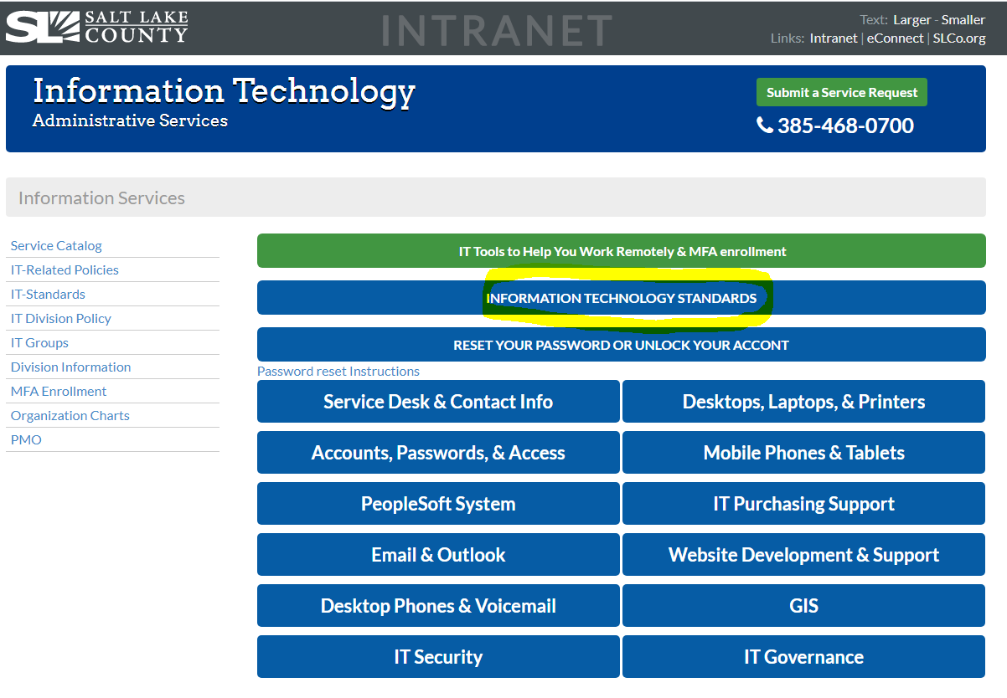

Slide 44
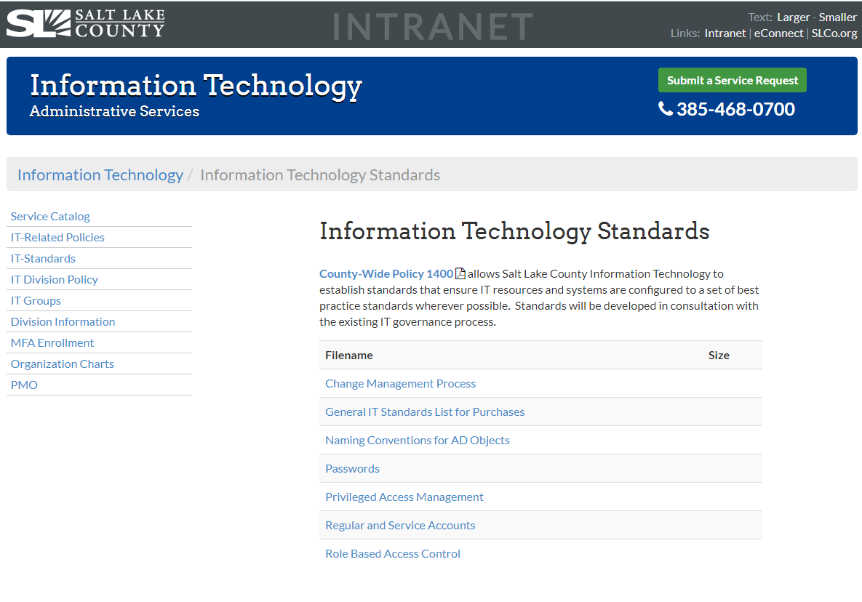

Slide 45
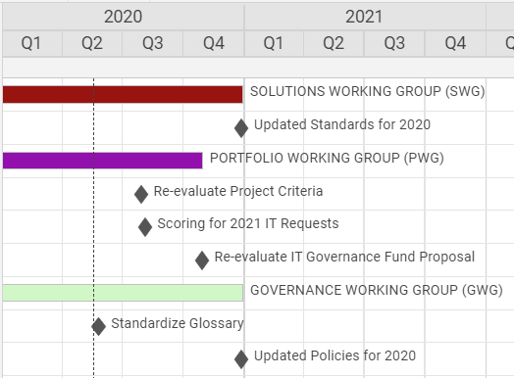
Working Groups – Milestone Chart –
Zach Posner

Slide 46
IT Working Group Updates

Slide 47
Windows 7 Replacement Update – Brandon Allgier
Remaining Windows 7 Machines
 | January | May
Addressing | 3 | 2
Aging & Adult Services | 4 | 4
Animal Services | 20 | 11
Children's Justice Center | 1
Council - Tax Administration | 8 | 7
County Mayor | 2 | 1
Criminal Justice Services | 1 | 1
District Attorney | 43 | 24
District Attorney - Tax Admin. |  | 1
Engineering & Flood Control | 4 | 4
Facilities Management | 2 | 2
Facilities Services | 21 | 22
Fleet | 1
Fleet Management | 3 | 2
Health |  | 1
Health Department |  | 2
Information Services | 19 | 14
Mayor | 1 | 1
Mayor's Finance | 4 | 3
Municipal Services District | 2
Parks & Recreation | 76 | 36
Parks and Recreation | 1
Printing | 1 | 1
Public Works | 1 | 2
Public Works Operations | 3 | 4
Real Estate | 1
Recorder | 1 | 1
Regional Transportation, Housing & Economic Development | 5
Sanitation | 1 | 4
Sheriff | 10 | 8
Solid Waste | 4 | 5
Surveyor | 1
Treasurer | 1
Unified Police Department | 63 | 42
*Counts are likely affected by COVID
Notes:
Total is approximately 205 for May. It was 308 in January. Some old machines have come back on-line.

Slide 48
Glossary Update
Trevor Hebditch
Motion and Roll Call Vote

Slide 49
Communication Items - Mayor and Council
Zach Posner & Chair
1. Voting Equipment
2. Policy 1400-7

Slide 50
Meeting Schedule For 2020
Kristine Pepin
9:00 – 10:30 a.m.
July 9th
August 13th – 10:00 a.m. – 11:30 a.m.
August 19th – Wednesday – 9:00 a.m. to 10:00 a.m.
October 22nd
December 10th

Slide 51
Review Action Items
Kristine Pepin

Slide 52
Thank
Next Meeting – 07/09/2020
Thank
You
You!

Slide 53
Agenda
Public Comments - Chair - 3 min (9:00 – 9:03)
Approve Minutes from 1/23/20 Meeting - Chair - 2 min (9:03 – 9:05)
Open & Public Meetings Act Training – Dianne Orcutt – 10 min (9:05 – 9:15)
Follow-Up Items:
  SharePoint Document Management Update (Informational) – Lee Wilstead – 5 min (9:15 - 9:20)
  County-Wide Website Redesign Update (Informational) – Megan Hillyard– 5 min (9:20 – 9:25)
  Data Working Group Update (Informational) – Javaid Lal, Beth Graham, & Jeff Eason– 10 min (9:25 – 9:35)
  Voting System & Equipment Update (Discussion/Approval) – Pam Tueller & Lannie Chapman - 10 min (9:35 – 9:45)
IT Lessons Learned – COVID (Informational) – Zach Posner – 10 min (9:45 – 9:55)
Budget Update – (Informational) – Cherie Root – 5 min (9:55 – 10:00)
Policy and Standards (Discussion/Approval) – Mark Evans – 5 min (10:00 – 10:05)
  Policy 1400-7 – Payment Card Industry Data Security Standard Policy
  IT Standards
    Secure Windows Device Configuration
    Secure Network Configuration
Working Groups Milestone Chart (Discussion/Direction) – Zach Posner – 3 min (10:05 – 10:08)
IT Working Group Updates
  SWG - Windows 7 Replacement Update (Informational) – Brandon Allgier - 5 min (10:08 – 10:13)
  GWG – IT Glossary Update (Discussion/Approval) – Trevor Hebditch – 3 min (10:13 – 10:16)
Communication Items - Mayor & Council – Zach Posner & Chair – 1 min (10:16 – 10:17)
2020 Meeting Schedule (Informational) -– 1 min (10:17 – 10:18)
Review Action Items – Kristine Pepin - 2 min (10:18 – 10:20)
Next Meeting – 7/09/20 – Chair - 1 min (10:20 – 10:21) APPROVAL TO ADJOURN

Slide 54
TO-DO List

Slide 55
Journal Technologies (JTI) Needs Updating
- Case Management Support for live system
- Funding by agency
- Next Steps
JTI CASE MANAGEMENT SYSTEM (eProsecutor)
DISTRICT ATTORNEY FUNDING PROJECTION
DA | 2017 | 2018 | 2019 | 2020 | 2021 | 2022 | 2023 | 2024
Beginning Balance | 690,000 | 690,000 | 690,000 | 690,000 | 66,000
Base Budget (NEW REQUEST) |  |  |  |  | 239,880 | 309,838 | 313,874 | 317,992
Available Funds | 690,000 | 690,000 | 690,000 | 690,000 | 305,880 | 309,838 | 313,874 | 317,992
Implementation -One-time* |  |  |  | 322,000
Annual Licensing/Maintenance-Ongoing** |  |  |  | 194,000 | 197,880 | 201,838 | 205,874 | 209,992
Annual Hosting-Ongoing |  |  |  | 108,000 | 108,000 | 108,000 | 108,000 | 108,000
Annual Amazon Storage-Ongoing |  |  | - | - | - | - | - | -
Ending Balance | $ 690,000 | $ 690,000 | $ 690,000 | $ 66,000 | $ - | $ 0 | (0) | 0
* This includes Implementation, Conversion and Interfaces.
** Year 2 forward includes a 2% increase as an estimate of the CPI increase that applies each year.
Notes:
CJS and YS won’t need a budget request.

