Slide 1

October 22, 2020

Slide 2
Remote Meeting Instructions
Trevor Hebditch
This meeting is being recorded.
If you want to make a comment, please raise your hand or put your comment in the chat.
Any comment in the chat will be addressed for the recording.
If you are joining via phone, you will be muted initially. During Public Comments, your phone will be un-muted and you will be able to make a comment if desired. You may also need to press “*6” to unmute your line.
Notes:
Remember to record meeting

Slide 3

Technology Advisory Board
Agenda
Public Comments - Chair - 3 min
Approve Minutes from 8/13/20 Meeting - Chair - 2 min
Follow-Up Items (Informational):
  County-Wide Website Redesign Update– Megan Hillyard– 5 min
  SharePoint Document Management Update – Tony Jolley– 5 min
Working Groups Milestone Chart (Discussion/Direction) – Tony Jolley– 3 min
IT Working Group Updates
  SWG - Windows 7 Replacement Update (Informational) – Mark Evans & Rina Shipley - 5 min
  GWG – Standards/Policy Update – (Discussion/Approval) – Mark Evans & Rina Shipley – 10 min
  PWG - Budget Update – (Informational) – Cherie Root – 10 min
County-Wide Technology FTE - (Discussion/Direction) – Cherie Root– 10 min
Budget Process Survey - (Discussion/Direction) – Tony Jolley – 10 min
Data Governance Working Group Update – (Informational) – Javaid Lal & Mark Evans – 5 min
Communication Items - Mayor & Council – Zach Posner & Chair – 1 min
Upcoming Meeting Schedule (Informational) – Kristine Pepin - 1 min
Review Action Items – Kristine Pepin - 2 min
Next Meeting – 12/10/20 – Chair - 1 min

Slide 4
Public Comments
Chair

Slide 5
Approve Minutes
Chair
Motion and Roll Call Vote

Slide 6
Review Follow – Up Items
Cherie Root
TASK | RESPONSIBLE
Windows 7 Replacement | Solution Working Group
SharePoint Document Management Update | Tony Jolley
County-Wide Website Redesign | Megan Hillyard
Voting System & Equipment Update | Jerome Battle
Communicate TAB support for Innovation Fund | Megan Hillyard
Meeting with Regional Development – Grant Opportunities | Zach Posner
Separate Slide
In-Process
Complete

Slide 7
County-Wide Website Redesign
Megan Hillyard

Slide 8
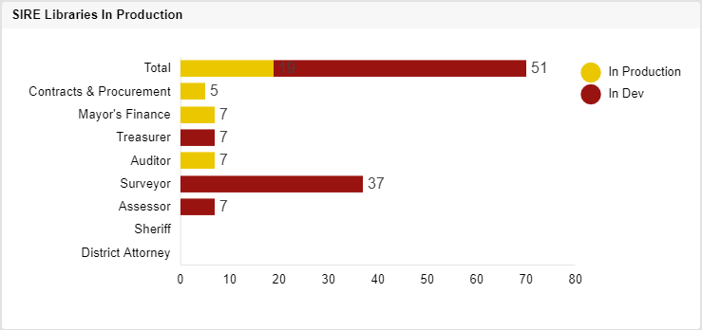
SharePoint Document Management
Tony Jolley
Libraries in Production
  Auditor – Migration Complete / Leveraging SharePoint Capabilities
      Automating ingestion of Decision Letters from Mainframe to SharePoint
  Remaining Agencies
    Treasurer – Adding Batch Processing Capability to Scan Tool
    Surveyor – Solutioning ingestion of Vue Works data
    Assessor – Continue to position for paperless BoE in 2021
Notes:
Although it looks as though there is not much headway on the slide in terms of migrating the remaining agencies, we’ve made significant process in advancements with the Decision Letters, Adding the Batch Processing Capability, and the work to ingest Vue Works data. A lot of coding/customization to process that leverage SharePoint in ways that SIRE could not be.
BoE – Board of Equalization

Slide 9
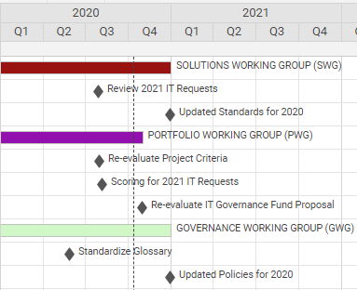
Working Groups – Milestone Chart
Tony Jolley
Notes:
Q3 has been busy for the SWG and PWG groups
- SWG reviewed the 2021 Budget requests for technical feasibilities
- PWG reviewed and prioritized the 2021 Budget requests from a County need perspective
Q4
- SWG will finalize the updated standards for the year.
- PWG will be re-evaluating the IT Governance Fund proposal (allocation for money for smaller projects)
- GWG will finalize updated Policies for the year.

Slide 10
IT Working Group Updates

Slide 11
Windows 7 Replacement Update – Brandon Allgier
Remaining Windows 7 Machines
Mark Evans & Rina Shipley
*Counts are likely affected by COVID
Notes:
Information Technology has been working for the past two years through TAB and our IT liaisons to ensure the organization was aware of the End of Life for Windows 7. Earlier this year on January 14, 2020, Microsoft ended support for the Windows 7 operating system, which means that Windows 7 machines are no longer receiving security patches. These unpatched machines pose a significant risk to the County’s network and data mostly from the threat of email and internet attacks. The IT Division has given agencies extra time to upgrade or replace their Windows 7 systems because of complications due to the COVID-19 crisis but we now need to set a hard deadline for mitigation of these machines.
Beginning December 1, 2020, Windows 7 machines will no longer have email or internet access.
If you need assistance with upgrading or replacing a Windows 7 machine, please submit a request through the Service Desk at 385-468-0700.
If you would like to request an exemption for a specific machine, please have your agency leadership contact Rina Shipley (rshipley@slco.org, 385-468-0712).
We appreciate your support of this initiative.

Slide 12

Standards/Policy Update
Mark Evans & Rina Shipley
Countywide Policy Update - 1400 - Information Technology Policy and Standards
Add requirement to follow IT Standards once established
Countywide Policy Update - 1400-1 Acceptable Use of Technology
New language about protecting passwords
Enhanced security awareness training program
New IT Standard - Employee Identifiers (EIDs)
New IT Standard - Secure MS SQL Database Configuration
New IT Standard - Secure Windows Server Configuration

Slide 13
Budget Update
Cherie Root
Link to 2021 Prioritization List

Slide 14
County-Wide Technology FTE Update
Cherie Root
Total IT positions in the County – 192 (This includes merit and time limited)
Total IT positions in County IT division – 102
Total IT positions in County agencies - 90
Notes:
There have not been any position changes into the IT Job Family or out of the IT Job Family during the last quarter. We did fix a couple mistakes from the last report where a position that had been cut was still included and two TL positions that were inadvertently left out. The only other changes this quarter have been some reclassifications within the technology positions that an agency already has (Library and IT).

Slide 15
Budget Process Survey
Tony Jolley
16 responses out of almost 100 surveyed
Common theme: They like the involvement and networking that governance brings
Common theme: There is support for smaller projects and an IT Governance Fund
Interest in reviewing scoring categories
TAB member indicated: They were never asked directly if there was a project that needed to be submitted
Notes:
1. Everyone who responded thinks the information provided is just the right amount.
2. There is a common theme that they like the involvement and networking that governance brings.
Quote (if asked)
“There seems to be lack of representation for smaller departments that live within bigger agencies. I was never directly asked if I had any items for TAB from anyone in my agency. So I'm wondering what we can do to mitigate that issue to ensure everyone is captured and asked if they have any requests instead of being left in the dark and having to figure it out last minute to make a submission.”

Slide 16
Data Working Group Update
Javaid Lal & Mark Evans
Data Coordinators Training – September 14 – Javaid Lal
  16 Data Coordinators attended the training
  Additional trainings will be schedule in the coming months
Phase 1 – Application Inventory - Javaid Lal
  Inventory survey finalized - https://app.smartsheet.com/b/form/d458dcc017b3475c935adce5097634be
  Inventory pilot – October/November
    Surveyor
    District Attorney’s Office
    Fleet Management
    Health Department
    Animal Services
County Data Risk Assessment and Data Governance – Mark Evans

Slide 17
Communication Items - Mayor and Council
Zach Posner & Chair

Slide 18
Meeting Schedule For 2020
Kristine Pepin
December 10th – 9:00 AM – 10:30 AM
Notes:
August 19 will be a final vote and few standards to review

Slide 19
Review Action Items
Kristine Pepin

Slide 20
Next Meeting – 12/10/20
Thank - You
Motion and Vote to Adjourn

Slide 21
TO-DO List

Slide 23
Technology Advisory Board
Slide Title

Slide 24
Technology Advisory Board
Slide Title
Numbered List
Numbered List
Numbered List
Numbered List
Numbered List
Numbered List

Slide 26
Technology Advisory Board
Agenda
Public Comments - Chair - 3 min (9:00 – 9:03)
Approve Minutes from 8/13/20 Meeting - Chair - 2 min (9:03 – 9:05)
Follow-Up Items (Informational):
  County-Wide Website Redesign Update – Megan Hillyard– 5 min (9:05 – 9:10)
  SharePoint Document Management Update – Tony Jolley– 5 min (9:10 -– 9:15)
Working Groups Milestone Chart (Discussion/Direction) – Tony Jolley– 3 min (9:15 – 9:18)
IT Working Group Updates
  SWG - Windows 7 Replacement Update (Informational) – Mark Evans & Rina Shipley - 5 min (9:18 – 9:23)
  GWG – Standards/Policy Update – (Discussion/Approval) – Mark Evans & Rina Shipley – 10 min (9:23 – 9:33)
  PWG - Budget Update – (Informational) – Cherie Root – 10 min (9:33 – 9:43)
County-Wide Technology FTE - (Discussion/Direction) – Cherie Root– 10 min (9:43- 9:53)
Budget Process Survey - (Discussion/Direction) – Tony Jolley – 10 min (9:53 – 10:03)
Data Governance Working Group Update – (Informational) – Javaid Lal & Mark Evans – 5 min (10:03 – 10:08)
Communication Items - Mayor & Council – Zach Posner & Chair – 1 min (10:08 – 10:09)
Upcoming Meeting Schedule (Informational) – Kristine Pepin - 1 min (10:09 – 10:10)
Review Action Items – Kristine Pepin - 2 min (10:10 – 10:12)
Next Meeting – 12/10/20 – Chair - 1 min (10:12 – 10:13)

