Slide 1

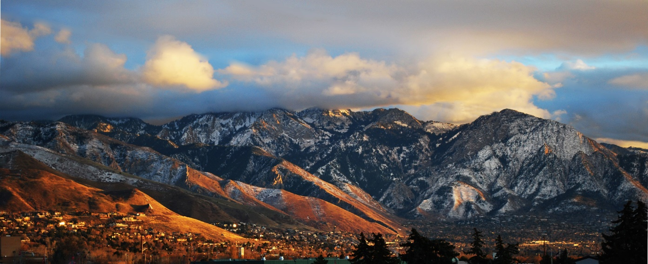





Upper Mill Creek Canyon Road Improvements Project
Public Meeting No. 3, June 13 (virtual) and June 14 (in person)
Environmental Review Process and
Preliminary Design Update
Notes:
Add Date and time

Slide 2
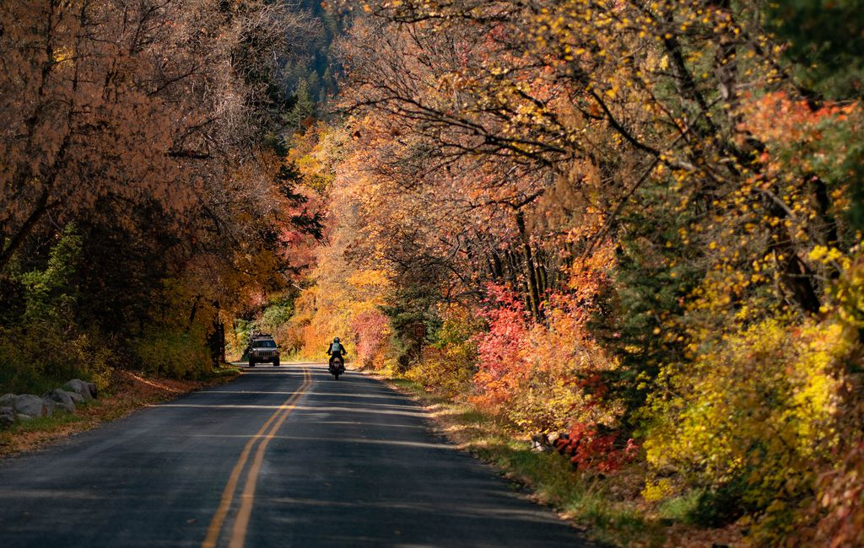
Agenda
  Project Background
  Activities to Date
  Design Update
  Environmental Update
  Schedule
  Next steps
Source: Salt Lake Tribune
Agenda
Slide 2 of 32

Slide 3
Project Background

Slide 4



Project Partners
  Federal Highway Administration Central Federal Lands Highway Division (FHWA-CFLHD)
  Salt Lake County
  Millcreek
  US Forest Service (USFS), Uinta-Wasatch-Cache National Forest
FHWA Federal Lands Access Program
  Improve transportation facilities on or adjacent to federal lands
  Emphasis on high-use federal recreation sites
  Supplements state and local resources for public roads, transit systems, and other transportation facilities
  Federal and local match: costs are split between federal and local project partners
Project Partners and the Federal Lands Access Program
Slide 4 of 32
Notes:
County and USFS
Partners to present through this slide and then transition to Braden for FLAP project selection
Several FLAP projects have been completed or are in progress in Utah
Note the ~75/25 match

Slide 5
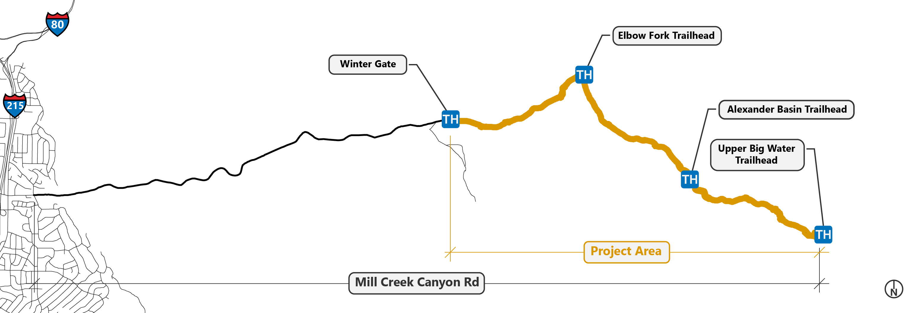
Purpose
  Enhance access and safety for motorists and recreationists using upper Mill Creek Canyon Road
Needs to Address
  Deteriorating road condition
  Variable road width
  Lack of bicycle and pedestrian infrastructure
  Informal roadside parking that causes safety concerns
Purpose & Need / Project Location
Slide 5 of 32
Notes:
REFORMAT
-2024 costs, escalation assumed 4% which has been exceeded in the last 2 years
-revise “City of Millcreek” label

Slide 6
Activities to Date

Slide 7
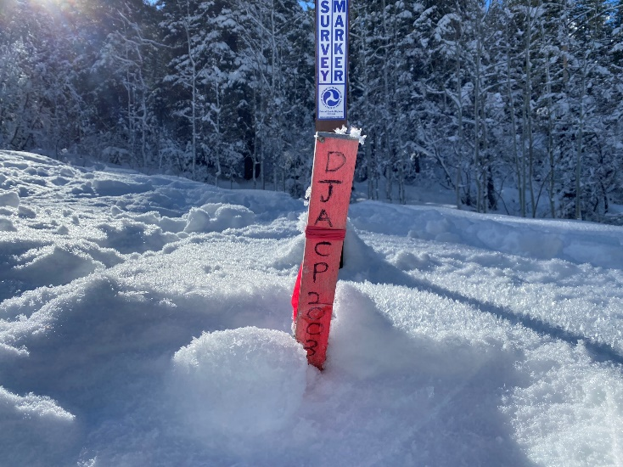
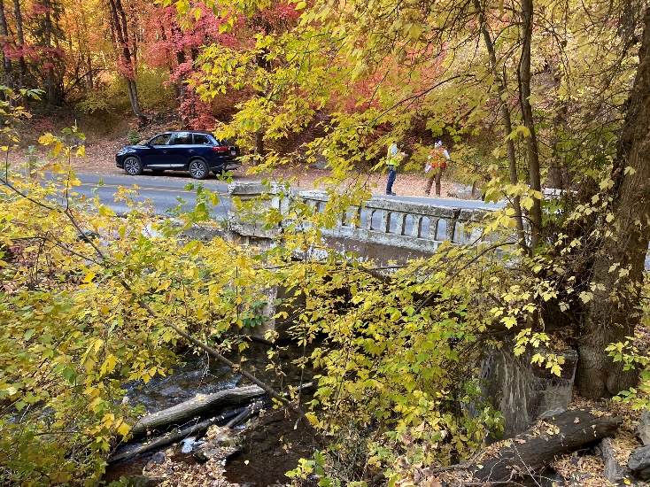
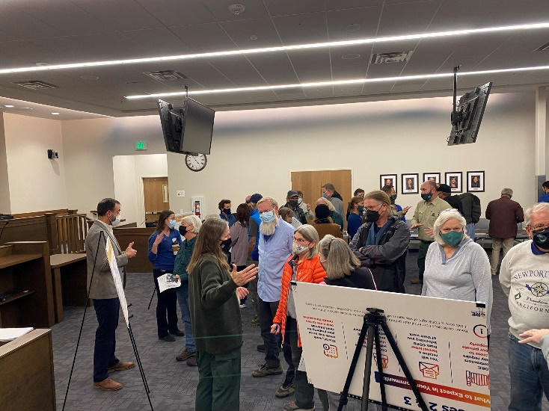
Public Meetings
  Two public open houses to gather input (Nov. 2021, May 2022)
  Cabin Association coordination
Agency Meetings and Involvement
  FHWA-CFLHD and USFS coordination
  Utah SHPO coordination
Preliminary Design
  Survey
  Concept development
  Ongoing refinements
  Site reviews
Activities to Date
Slide 7 of 32

Slide 8
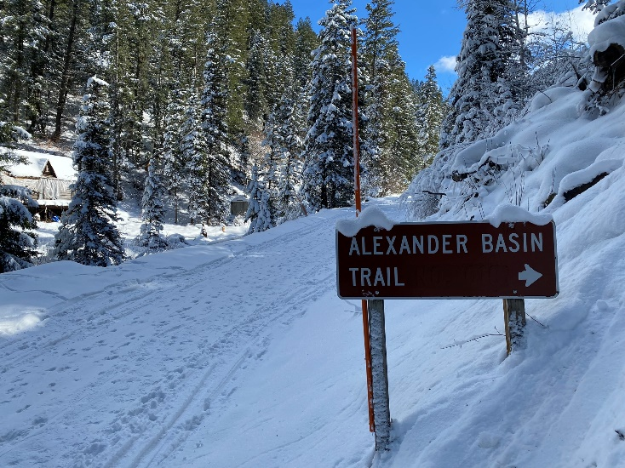
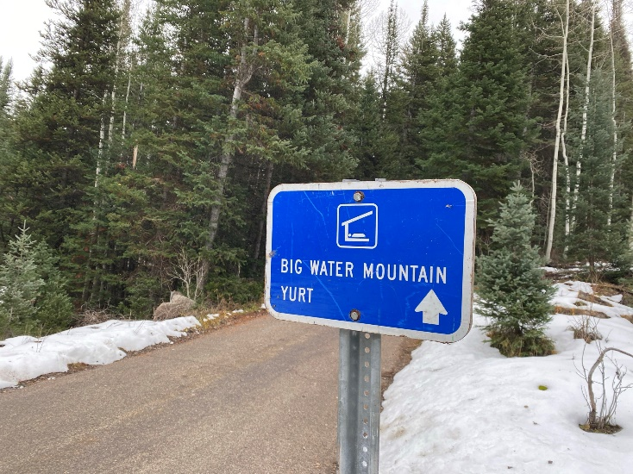
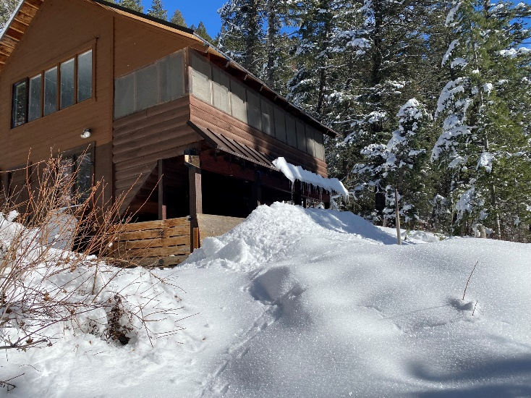
NEPA Class of Action
  Environmental Assessment
Environmental Studies
  Aquatic resources (streams, wetlands)
  Archeological resources
  Architectural resources
  Biological resources
  Other resources, such as land use and Inventoried Roadless Areas, visual resources, recreation and access
Activities to Date
Slide 8 of 32

Slide 9
Design Update

Slide 10
Proposed Improvements
  Roadway improvements
  Parking area improvements
  Bridge, culvert, and drainage improvements
  Other improvements
    Striping and signing
    Trail connections
    Sight distance improvements
    Communications
    conduit
Design Considerations
  Does it meet the purpose and need?
  Does it minimize environmental impacts?
  Does it enhance bicycle and pedestrian safety?
  Does it improve driver expectation?
  Can it be built?
  How much does it cost?
Proposed Improvements
Slide 10 of 32
Notes:
What we considered
The recommended alternative

Slide 11
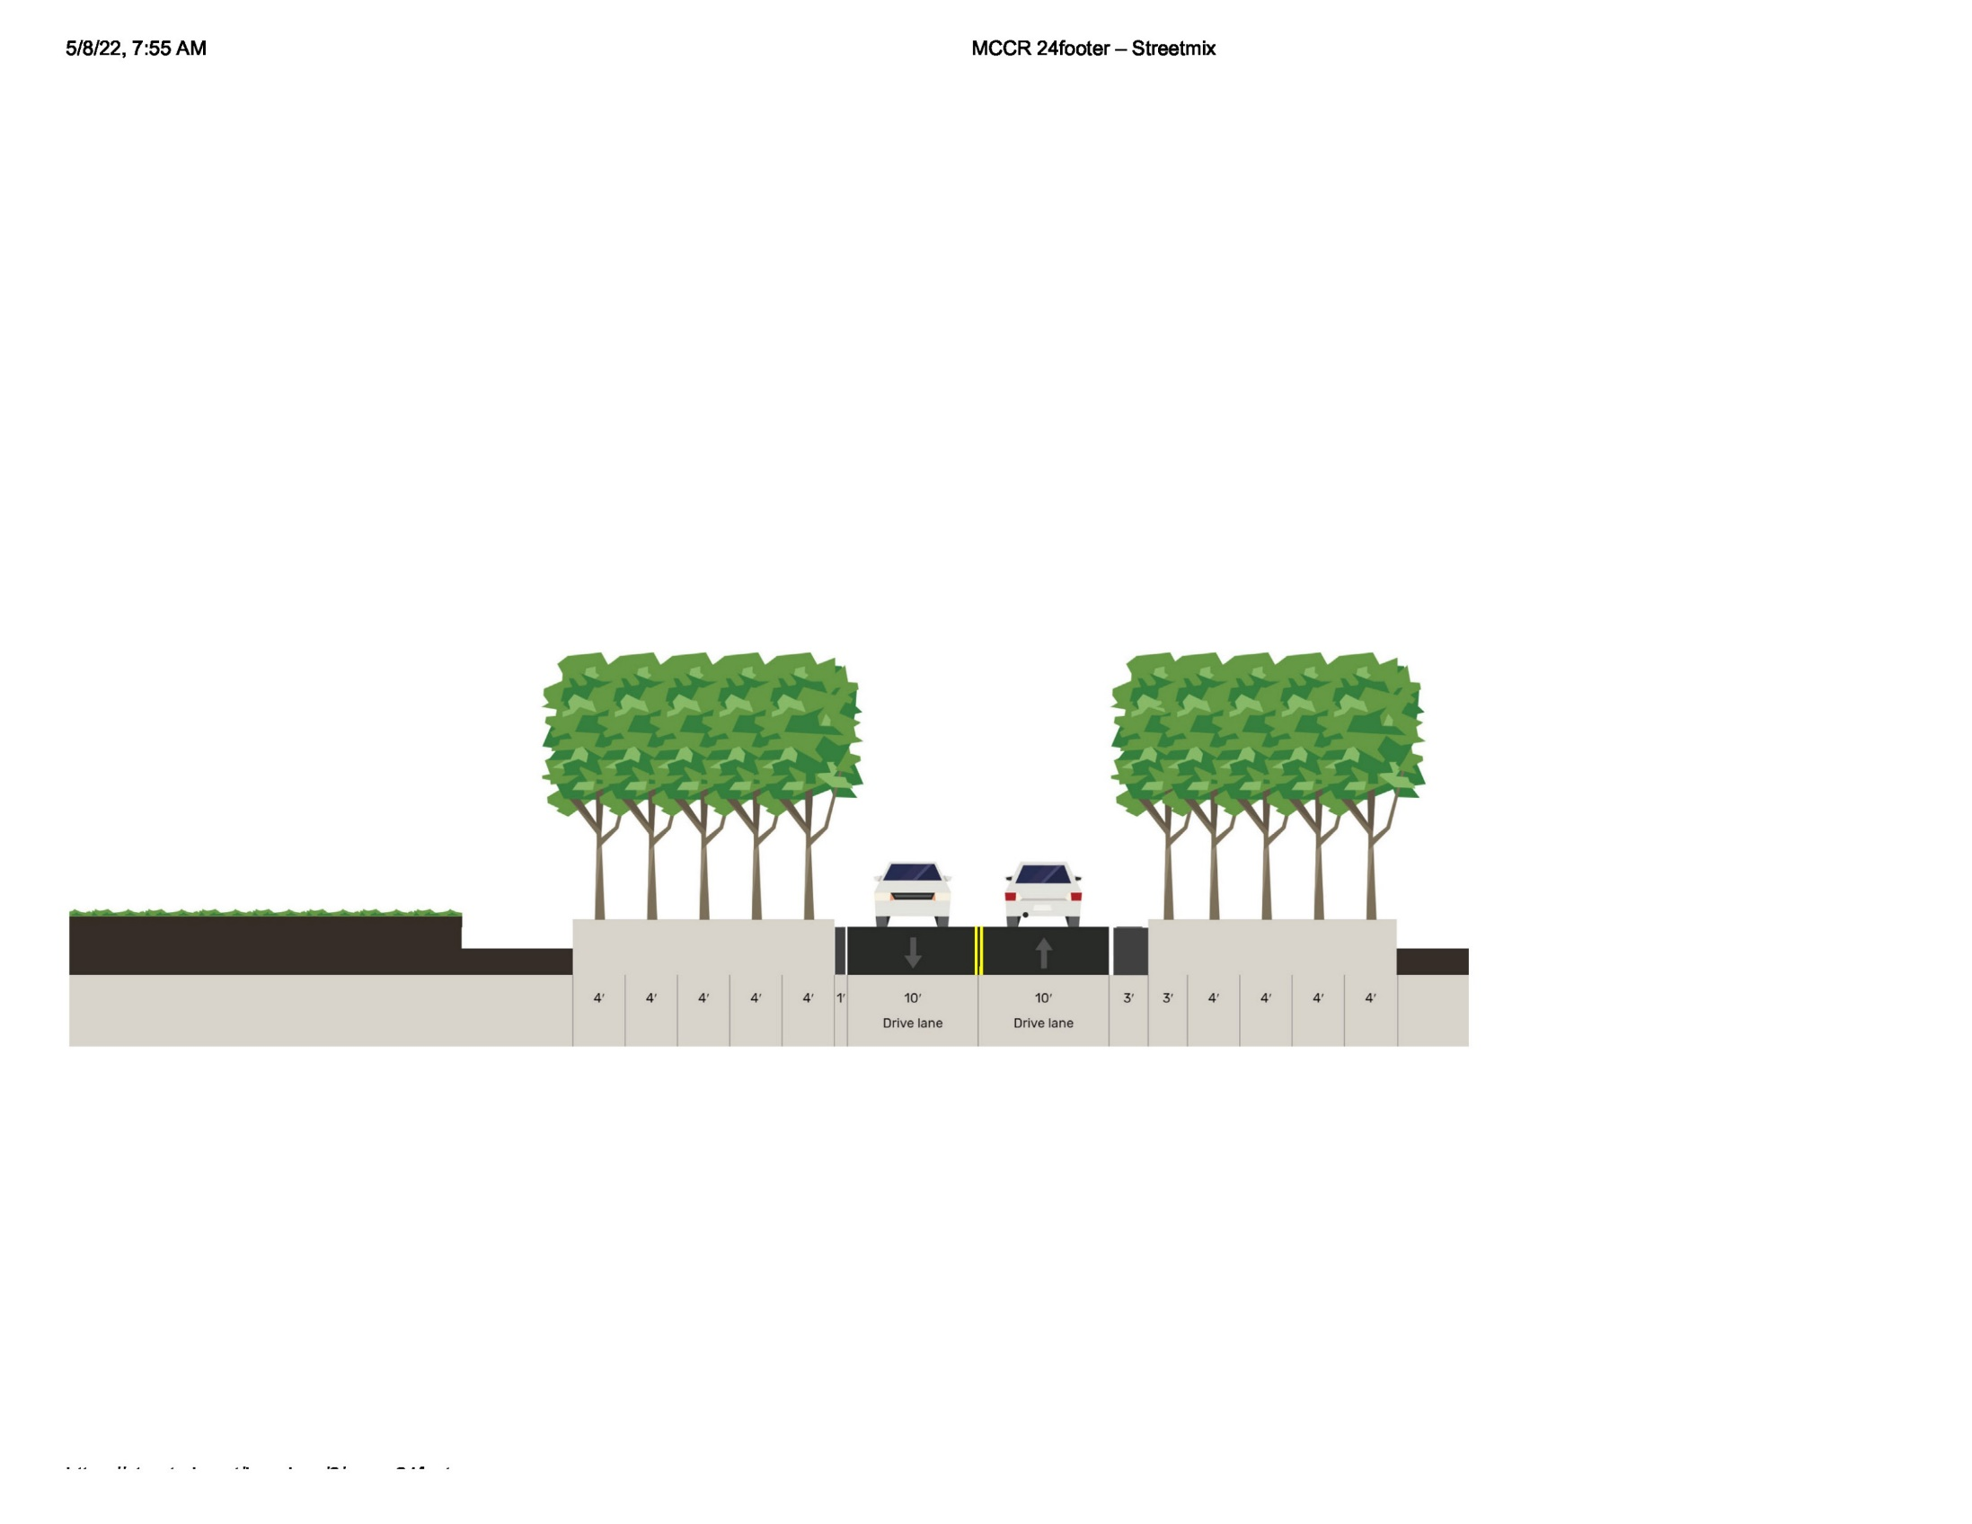
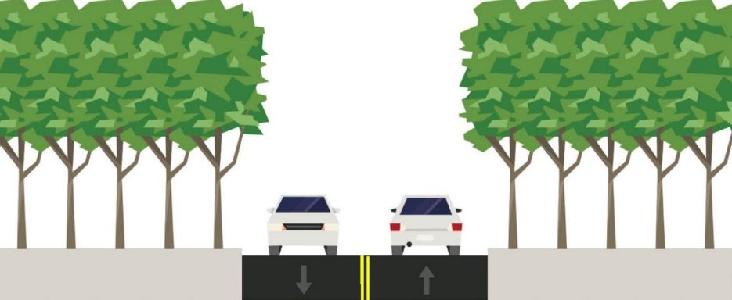
Conceptual Design
  29-foot-wide road, Winter Gate to Elbow Fork
  24-foot-wide road, Elbow Fork Trailhead to Upper Big Water Trailhead
Early Design
  18-foot-wide road
  20-foot-wide road
  24-foot-wide road
  Bicycle advisory lanes
24-foot roadway with 10-foot lanes with a 1-foot shoulder and 3-foot shoulder
Narrowest Roadway Concept: 20-feet wide with 10-foot lanes, no shoulders
Concepts Considered
Slide 11 of 32
Notes:
Shuttle system/mass transit
Changes to Winter Gate operation
Parking
Firs cabin owners
Increased speeds
Environmental concerns
Bicycle safety

Slide 12
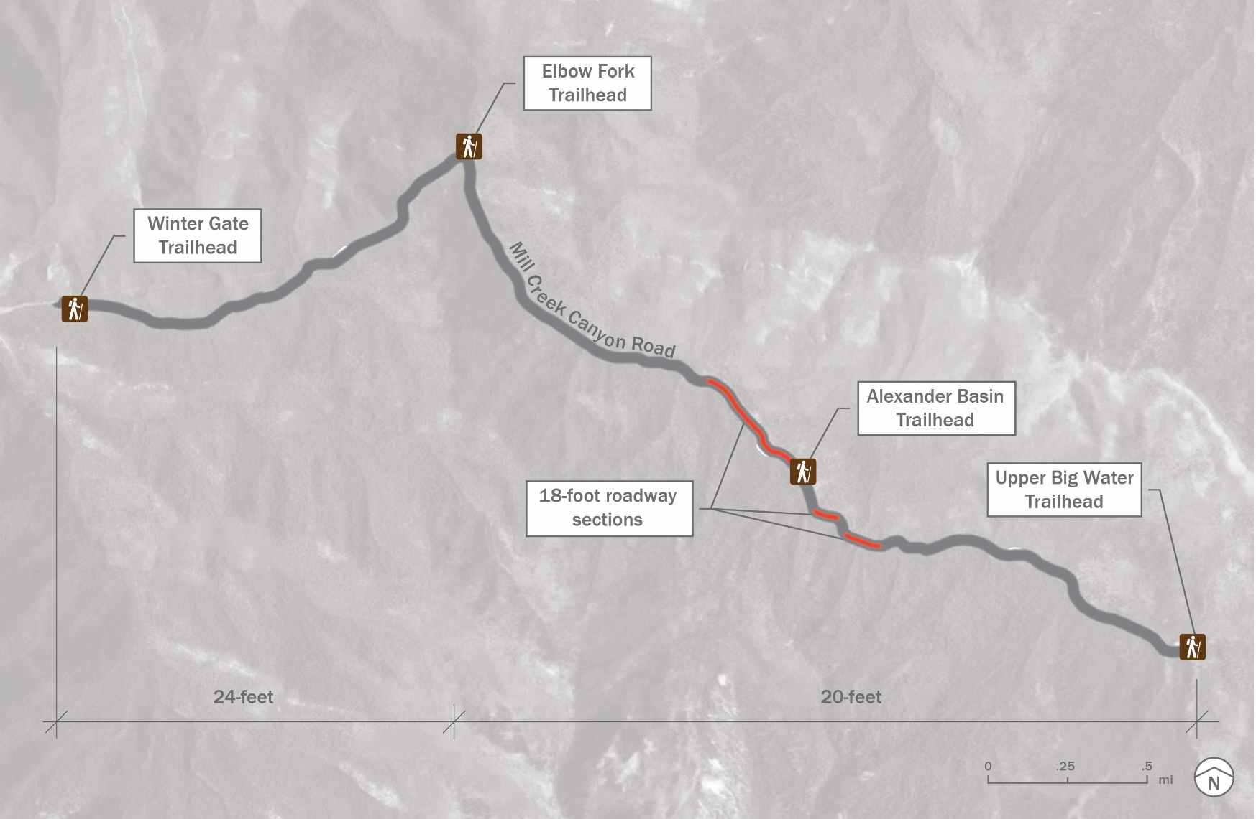
Three proposed roadway widths:
  Winter Gate to Elbow Fork, 24 feet wide
  Elbow Fork to Upper Big Water Trailhead
  20 feet wide
  At three constrained locations
  18 feet wide
Proposed Improvements: Roadway Improvements Overview
Slide 12 of 32
Notes:
Two widths are proposed because the character of the canyon changes, narrowing as one climbs up from Winter Gate towards Upper Big Water.
These two proposed cross sections allow for bicycle lane to be carried from Winter Gate to Elbow Fork and then minimization of impacts in the narrower portion of the canyon.

Slide 13
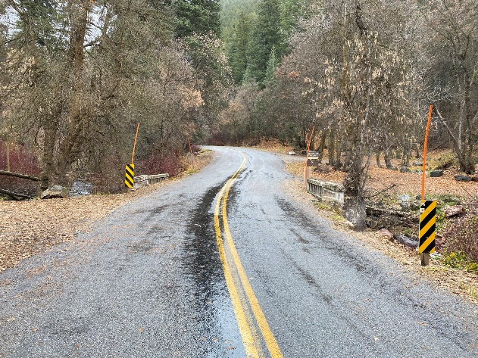
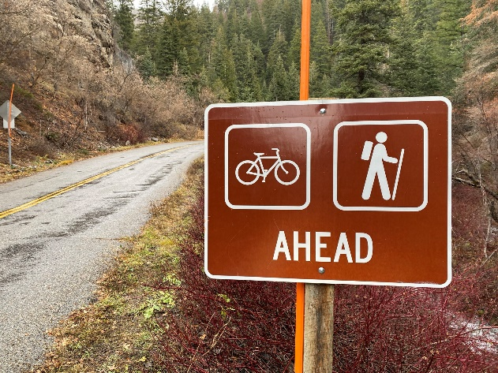
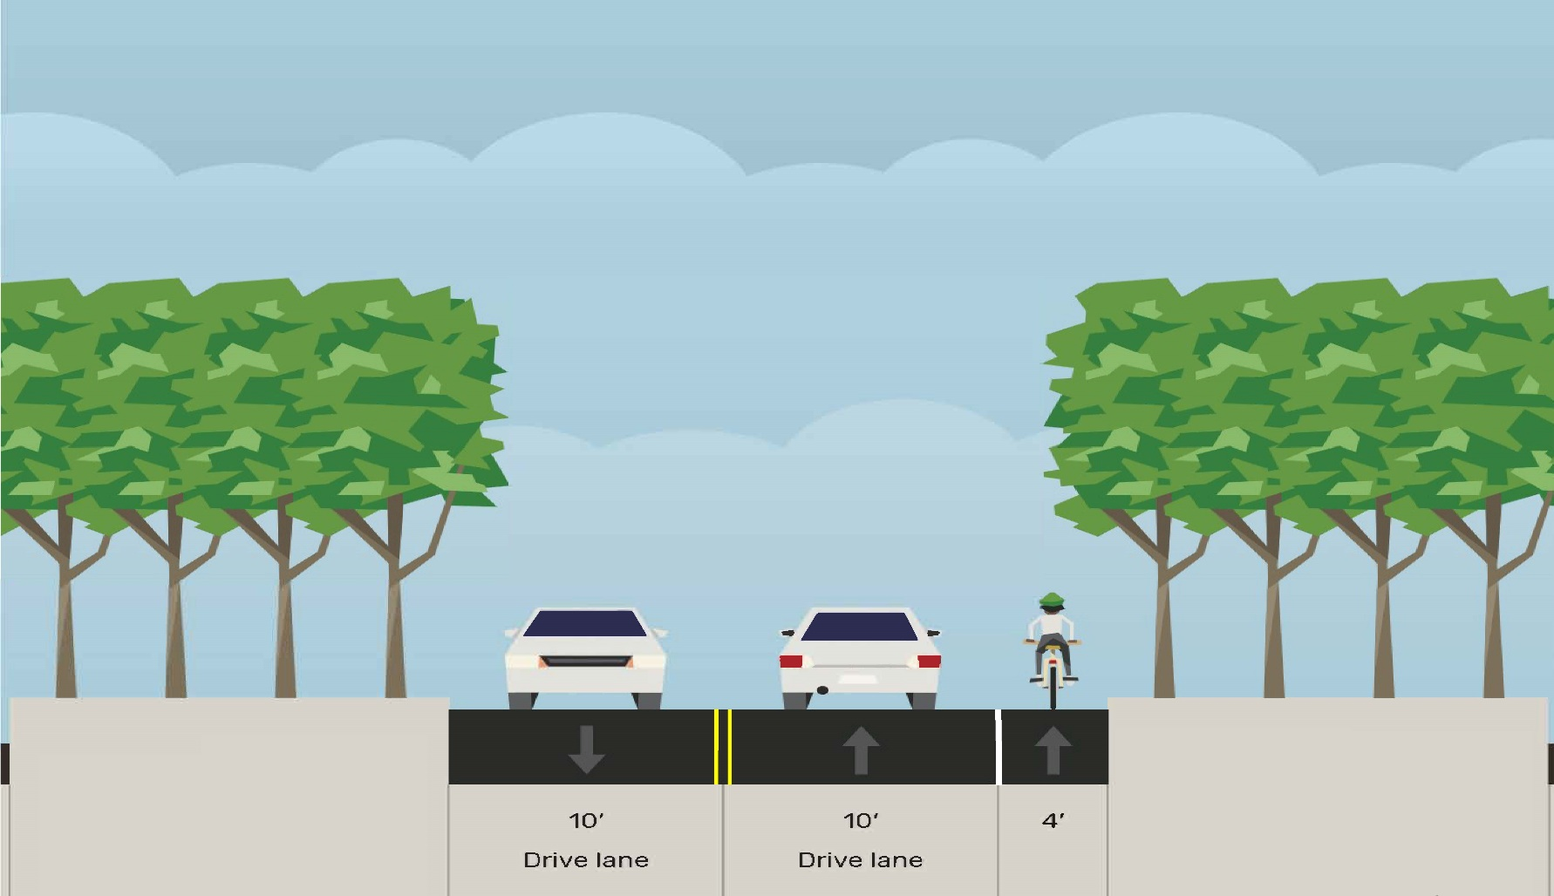

Existing
  1.4 miles long
  Width varies from 16 to 24 feet
Proposed
  24-foot-wide roadway
    Two 10-foot travel lanes
    One 4-foot bicycle lane on the uphill side
  Curve widening
PLACEHOLDER, GRAPHIC TO BE REVISED
Proposed Improvements: Roadway Improvements, Winter Gate to Elbow Fork
Slide 13 of 32

Slide 14
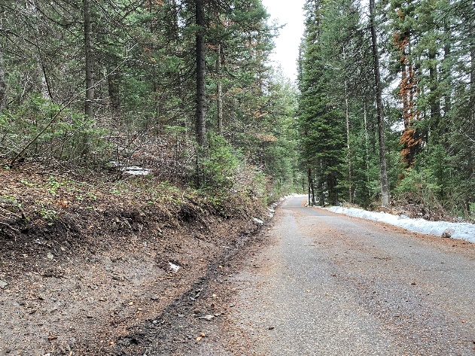
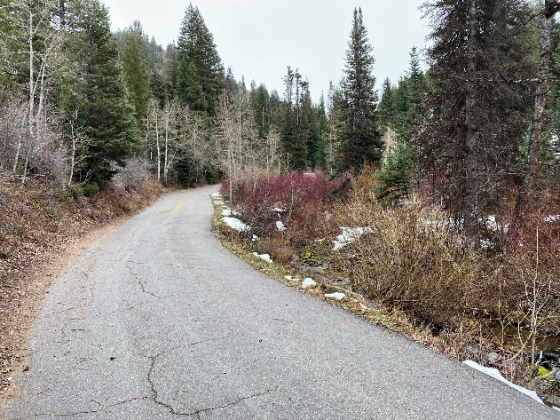
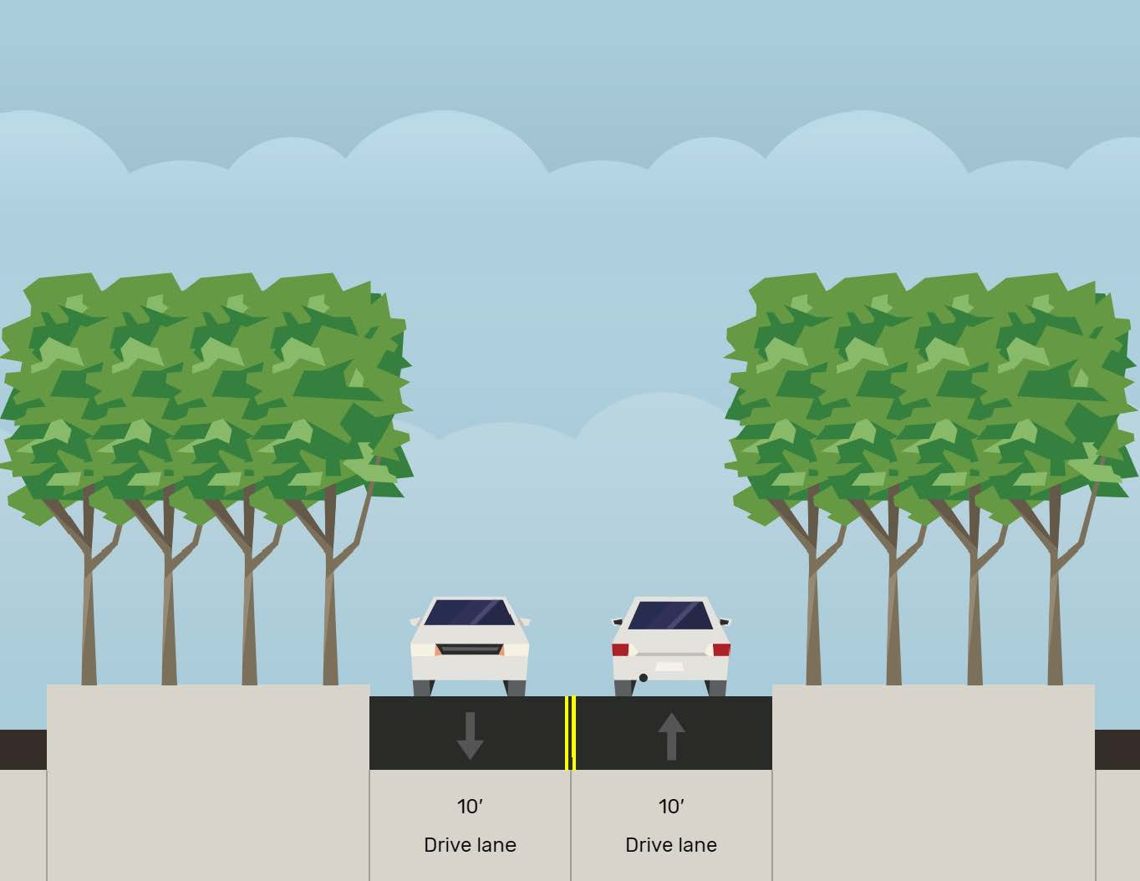

Existing
  3.2 miles long
  Width varies from 13 to 20 feet
Proposed
  20-foot-wide roadway
    Two 10-foot travel lanes
    Curve widening
  Minimizes impacts in the narrower upper canyon
PLACEHOLDER, GRAPHIC TO BE REVISED
Proposed Improvements: Roadway Improvements, Elbow Fork to Upper Big Water Trailhead
Slide 14 of 32

Slide 15
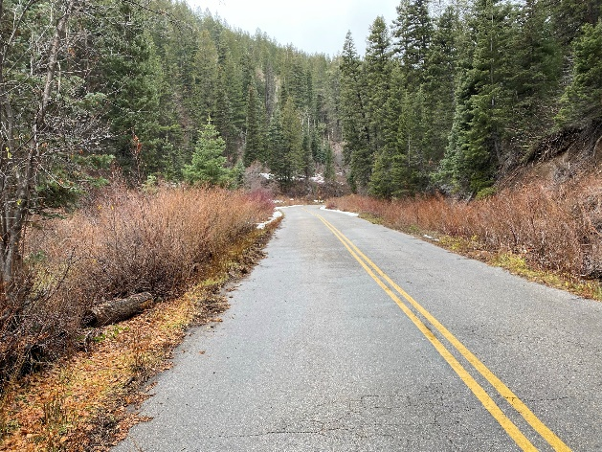
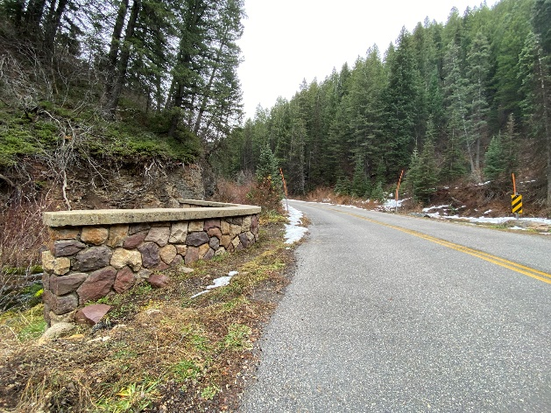
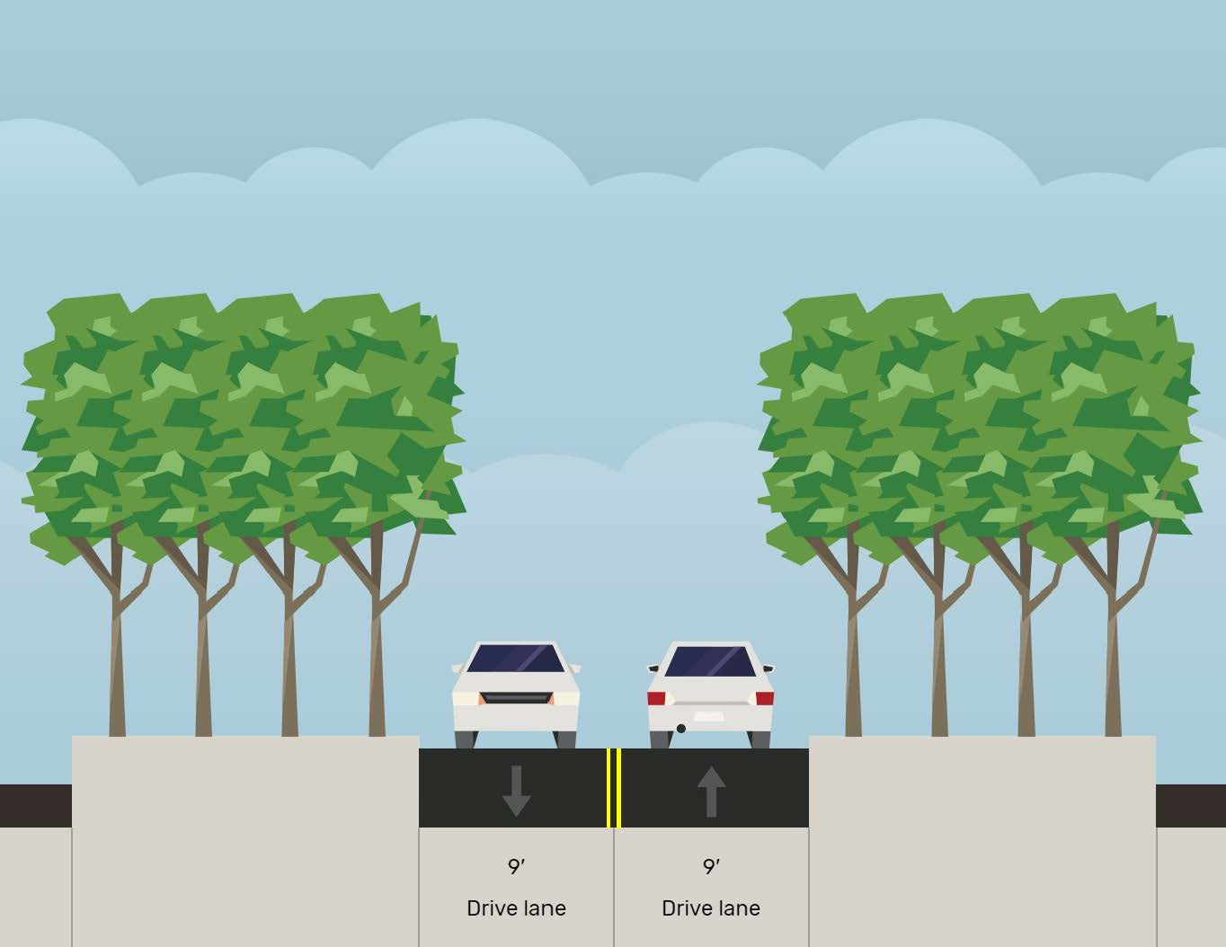
Existing
  Road near Firs Cabins, Thousand Springs, stone bridges, and “beaver pond”
Proposed
  18-foot-wide roadway
  Two 9-foot travel lanes
  A narrower road results in fewer impacts to the natural environment
Proposed Improvements: Roadway Improvements, Constrained Locations
Slide 15 of 32

Slide 16
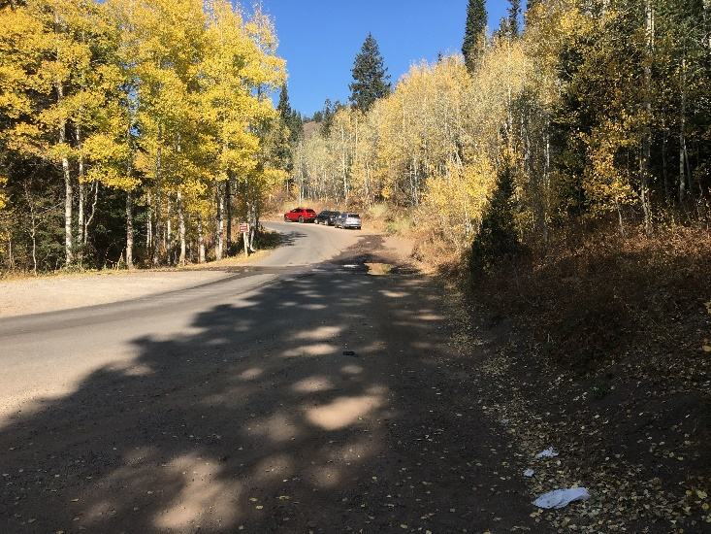
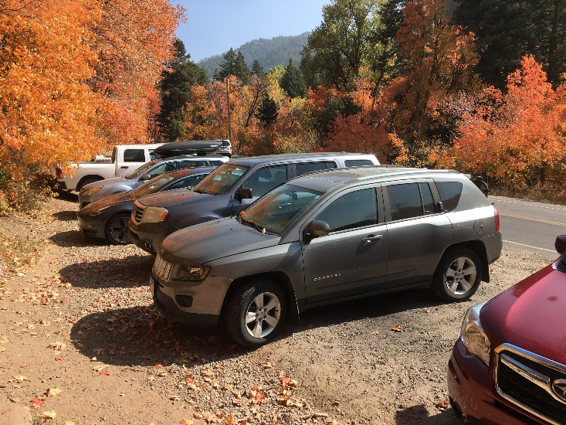
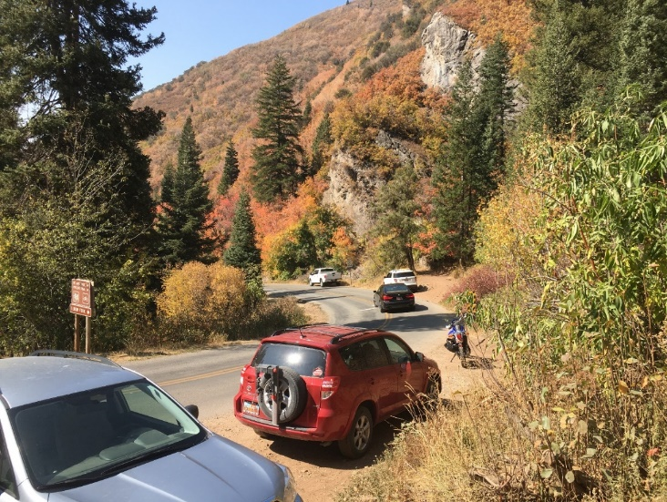
Why Alter Parking Areas?
  Improved circulation and access
  Easier maintenance
  Staging for emergency response
  Safety
  Accommodate future potential transit use
  Formalized parking reduces environmental impacts, such as erosion and social trails
Which parking areas are affected?
  Maple Grove Picnic Area (Winter Gate)
  White Bridge Picnic Area
  Elbow Fork Trailhead
  Alexander Basin Trailhead
  Upper Big Water Trailhead
  Informal Parking Areas
Proposed Improvements: Parking Area Improvements
Slide 16 of 32
Notes:
Canyon use has increased and evolved. Parking and access occur at areas on the roadway that were not designed nor intended for the volume and types of use, resulting in safety and environmental issues.
The Forest Plan recognizes the challenges and the balancing of uses to protect National Forest Sytem resources in light of growing populations and use. Consistent with growing use, the Forest Plan addresses the role of parking in managing capacity and supports the expansion of mass transit to address growth related transportation and parking issues.
The purpose of this project is consistent with that direction:
Formalization of parking areas without increasing the Canyon’s overall parking capacity.
Roadway improvements to facilitate potential future transit in the canyon.
For discussion

Slide 17
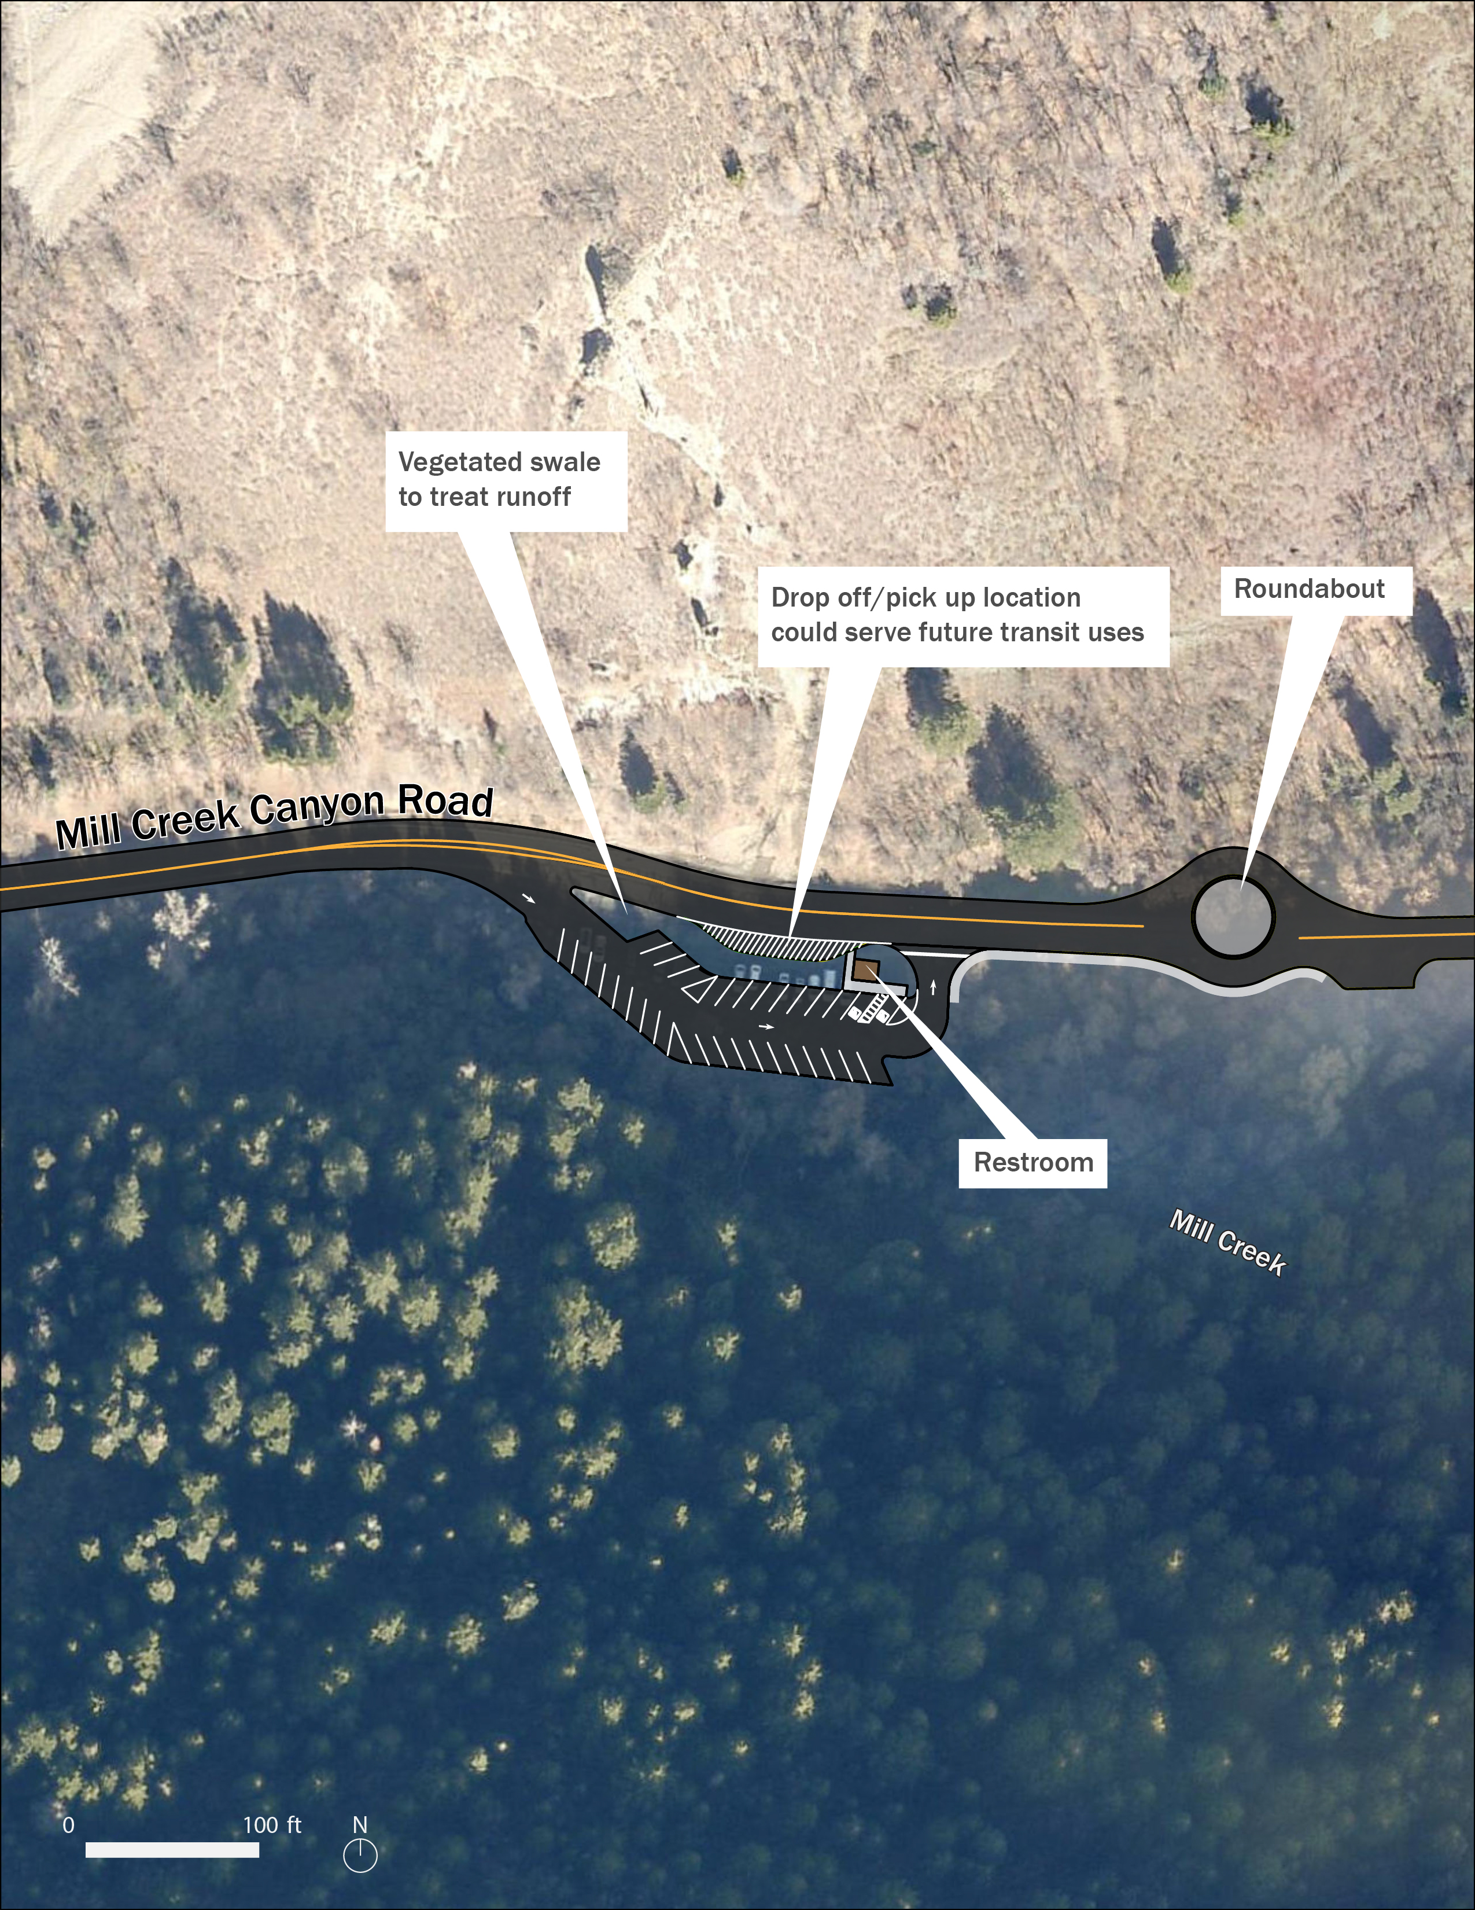
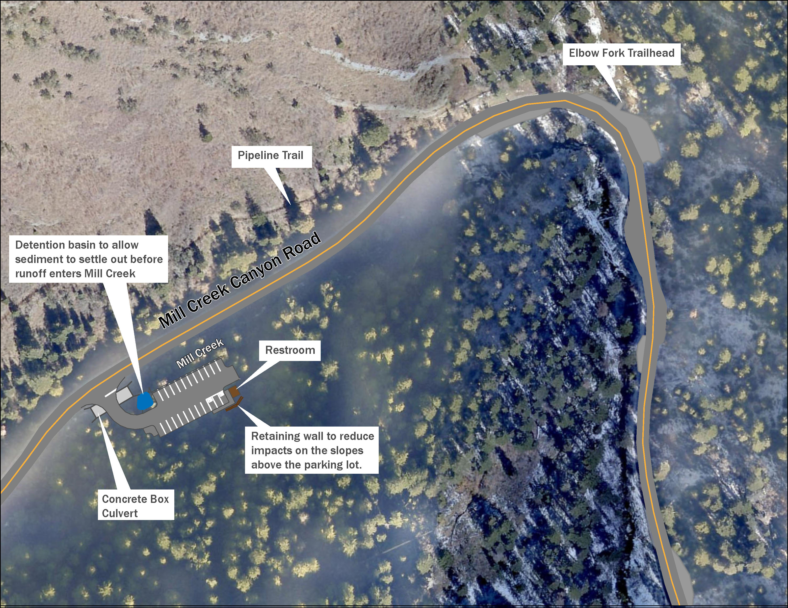
Winter Gate Parking Area
Elbow Fork Trailhead / Parking Area
Proposed Improvements: Parking at Winter Gate & Elbow Fork Trailhead
Slide 17 of 32
Notes:
Which concepts do we want to show?
Winter Gate
Elbow Fork-If we show Elbow Fork TH, it might be a discussion of trail connections
Upper Big Water
Capacity

Slide 18
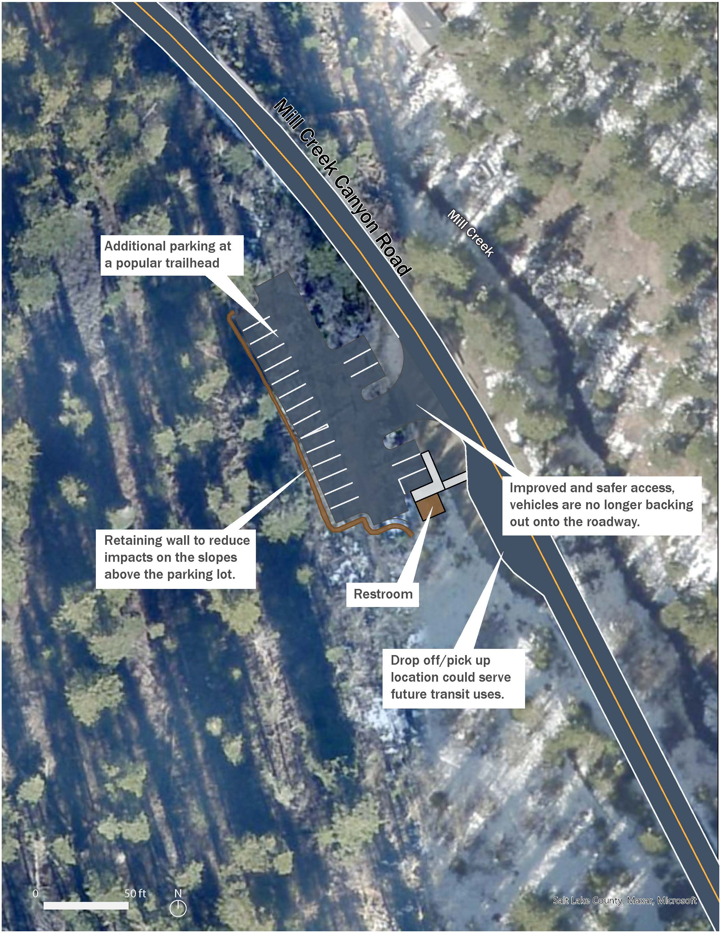
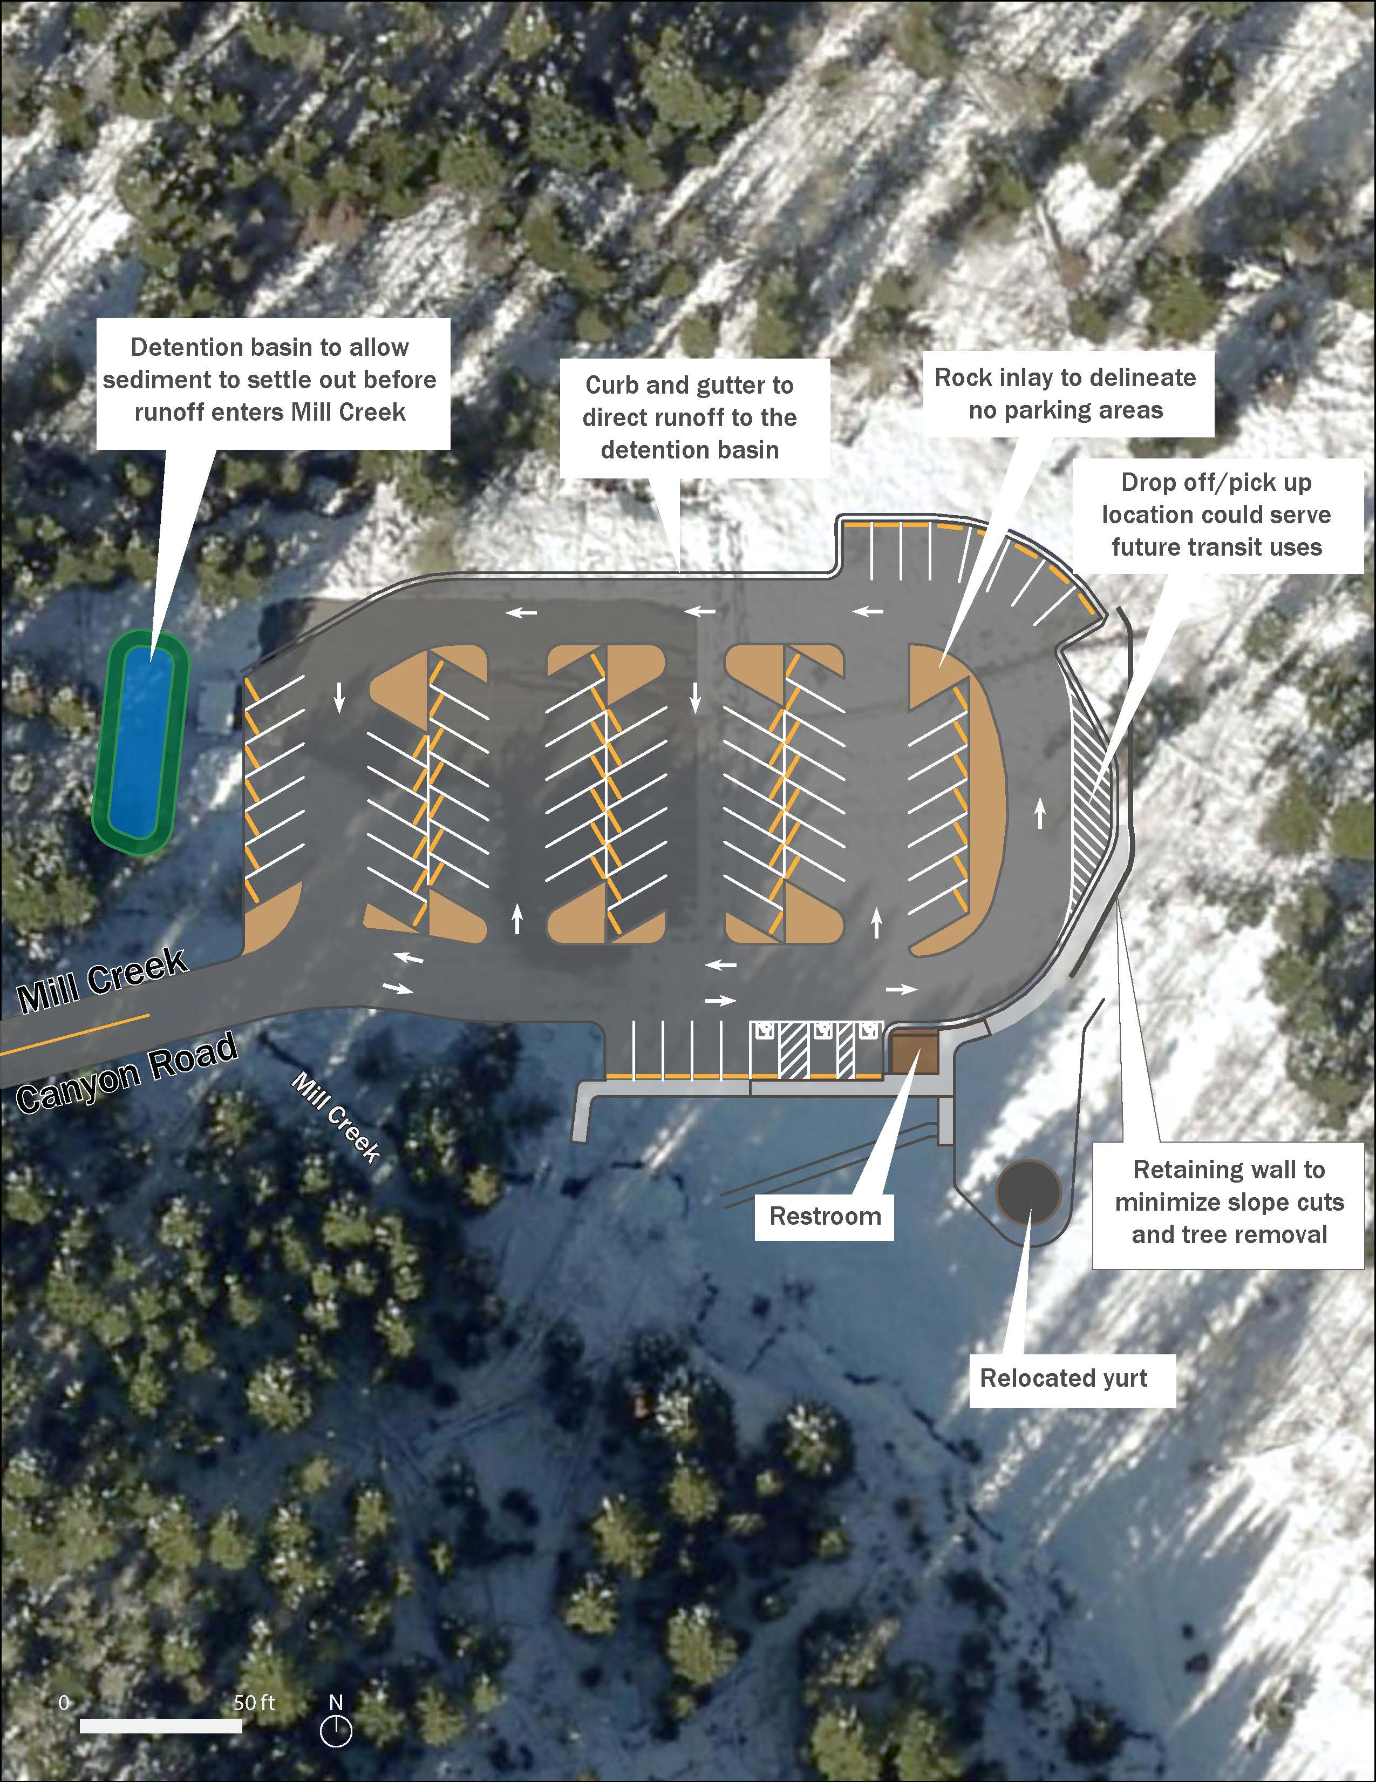
Alexander Basin Trailhead / Parking Area
Upper Big Water Trailhead / Parking Area
Proposed Improvements: Parking at Alexander Basin & Upper Big Water Trailheads
Slide 18 of 32
Notes:
Which concepts do we want to show?
Winter Gate
Elbow Fork-If we show Elbow Fork TH, it might be a discussion of trail connections
Upper Big Water
Capacity

Slide 19
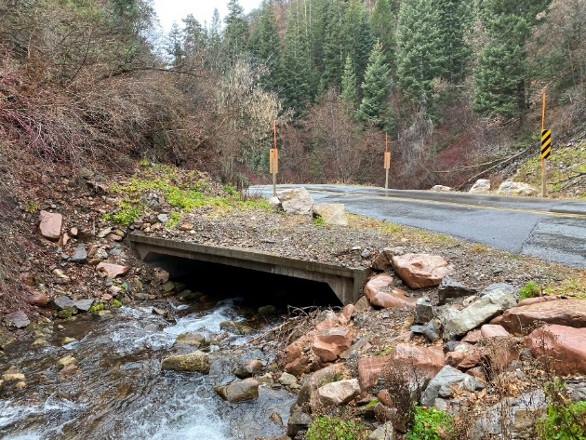
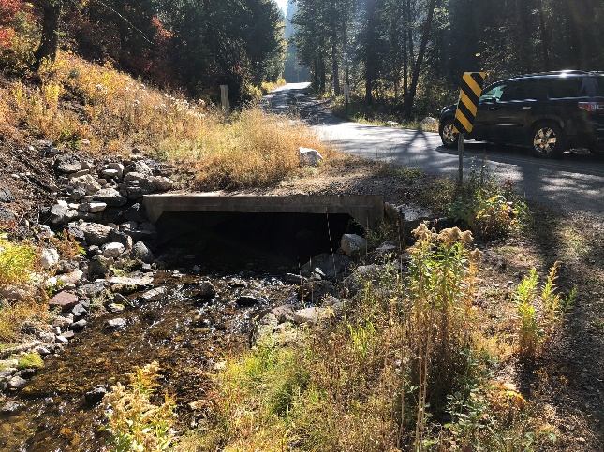
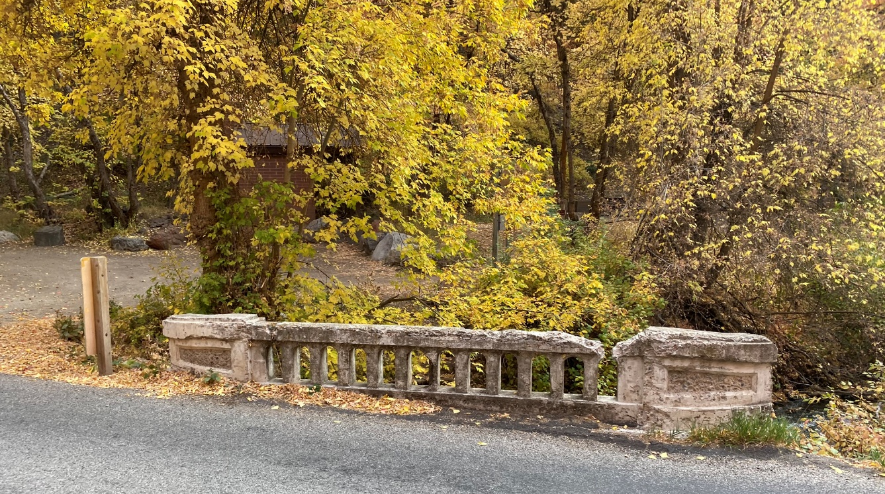
White Bridge replacement
  New bridge railing being designed to match the existing railing
Culverts
Water Quality Features
  Detention basins
  Swales
  Curb and Gutter
  Ditches
Proposed Improvements: Bridge, Culvert, and Drainage Improvements
Slide 19 of 32
Notes:
-note that White Bridge is a box culvert, replacement results in a wider x-section to accommodate bikes
-culvert headwalls and wingwalls will reduce erosion
-WQ features will reduce erosion, allow sediment to settle, and direct water
-note toilet relocations to match current USFS practices

Slide 20

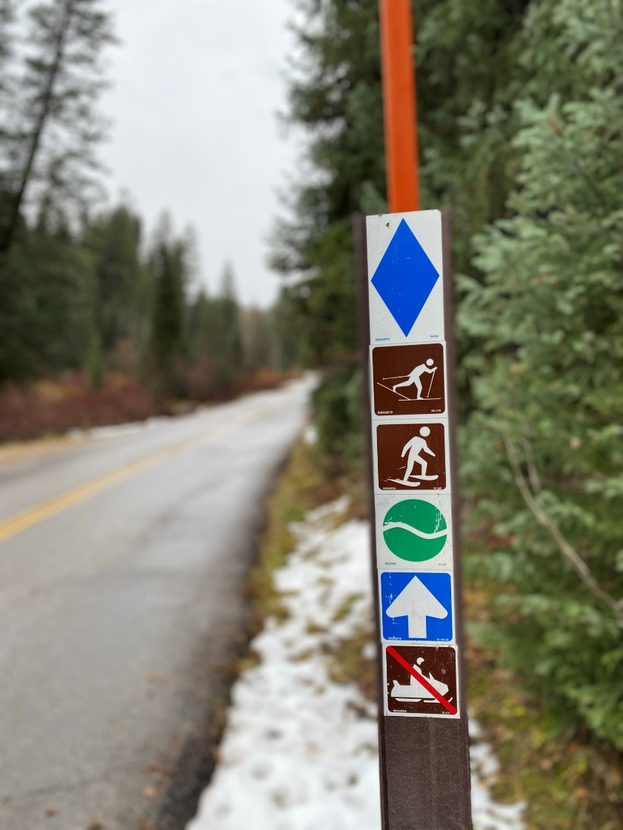
Other Associated Features and Improvements
  Striping and signing
  Crosswalks
  Pedestrian and bicyclist specific signage
  Trail connections
  Sight distance improvements
  Conduit for future communication
  Speed limit and other operations - unchanged
Proposed Improvements: Associated Improvements
Slide 20 of 32

Slide 21
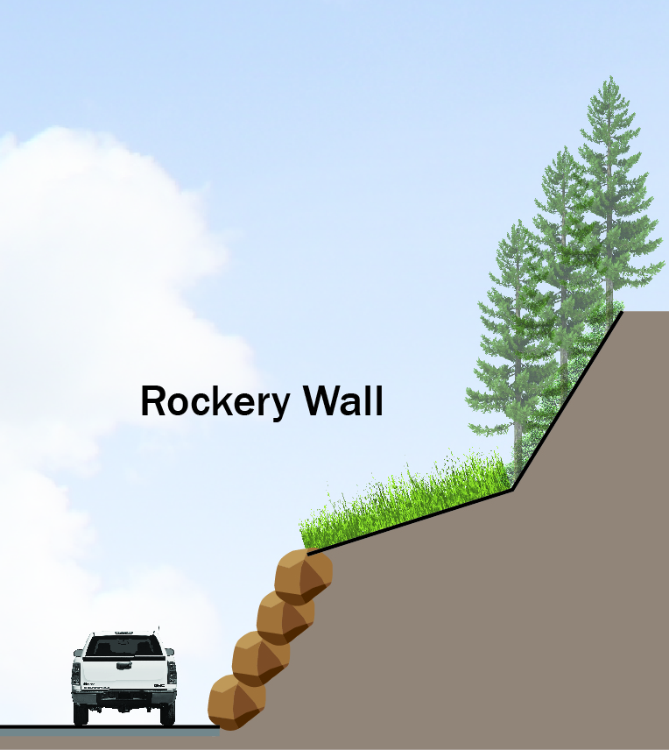
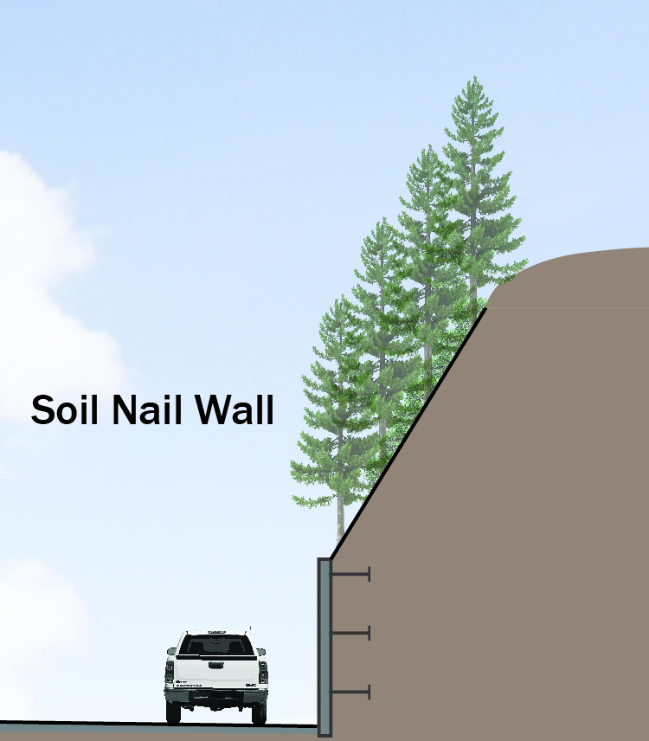
Retaining Walls
  Rockery Walls
    Constructed of boulders
    Require shallow slopes above them, so slope flattening and clearing may be required
  Soil Nail Wall
    Can be rock faced
    Can hold steeper slopes above, so less clearing
Proposed Improvements: Retaining Walls
Slide 21 of 32

Slide 22
Environmental Update

Slide 23
Environmental Assessment (EA)
  In response to public input, FHWA-CFLHD will prepare an EA
  The EA will describe the proposed action and present environmental consequences of the preliminary design
  Public will have an opportunity to review the EA before any decision is made on the project
  FHWA-CFLHD will prepare its decision document after the EA public review period
Criteria for Consideration
    Beneficial and adverse effects
    Concerns with public health or safety
    Impacts to sensitive resources, such as federally listed species, wetlands, and historic properties
    Individually insignificant but cumulatively significant impacts
    Public concerns related to environmental issues
NEPA Class of Action: Environmental Assessment
Slide 23 of 32
Notes:
Beneficial and adverse effects
Impact on public health or safety
Unique characteristics
Degree of controversy, uncertain/unknown risks
Precedent setting
Individually insignificant but cumulatively significant
Threatened or endangered species or critical habitat

Slide 24
  Air Quality
  Archeology
  Architectural History
  Aquatic Resources
  Biological Resources
  Environmental Justice
  Floodplains
  Land use
  Noise
  Paleontology
  Recreation
  Transportation
  Water quality
  Section 4(f)
  Section 6(f)
  Visual
  Roadless areas
Resource reports include:
  Aquatic Resources Delineation Report
  Archeological Resources Report
  Architectural Resources Report
  Cultural Resources Report (for public)
  Biological Resources Report (for public)
  Other Resources Report (for public), which includes aquatic resources, land use, visual resources, recreation and access
Typical EA Resource Topics
Slide 24 of 32
Notes:
- BRR includes T&E, USFS listed species, general wildlife, aquatic species, and vegetation

Slide 25
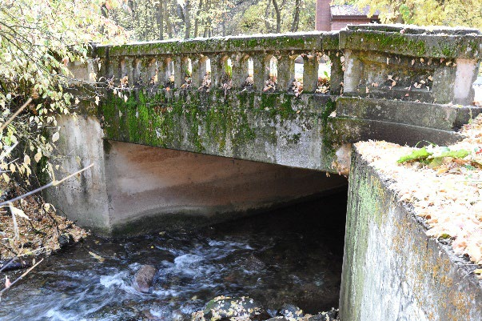
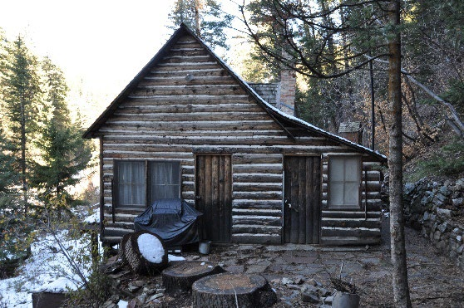
Historic Resources
  Eligible historic resources are also Section 4(f) properties
  Key resources include:
    Firs Cabins
    White Bridge
    Several smaller bridges
  Preliminary considerations:
    Visibility of proposed retaining walls from some cabins
    Replacement of White Bridge
    Modification of a stone bridge
    No modifications to any cabin properties or other bridges
Architectural Resources
Slide 25 of 32
Notes:
Developed in coordination with USFS, may include interpretive signage or recordation

Slide 26
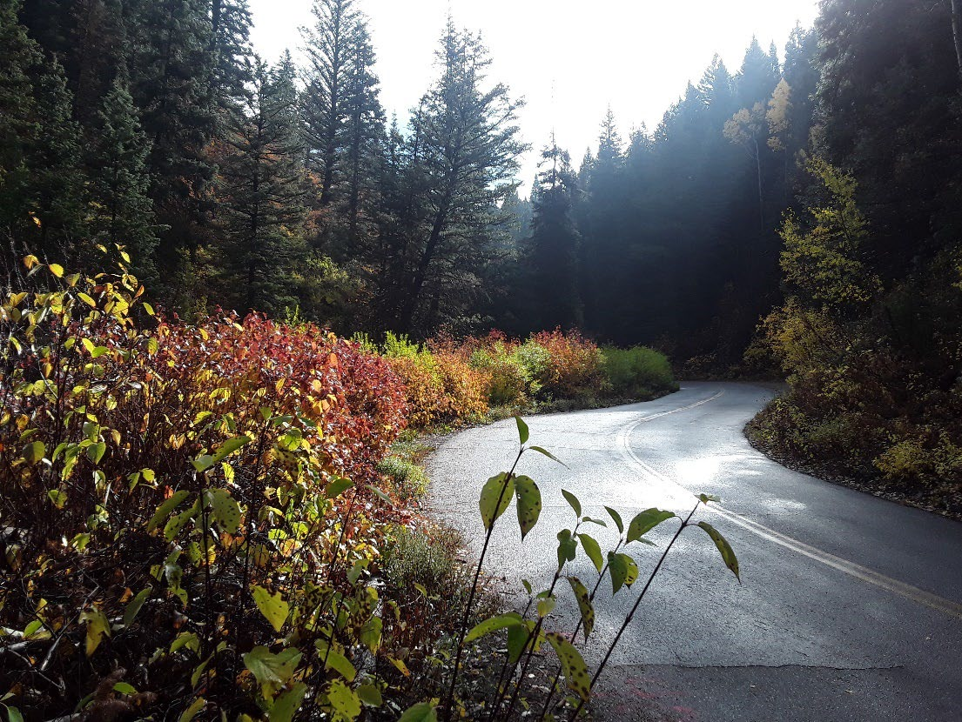
Archeological Resources
  Key resources include:
    Mill Creek Canyon Road
    Mill Creek Hydroelectric System
  Preliminary considerations
    Modifications to Mill Creek Canyon Road
    No modification to the Hydroelectric System
Archaeological Resources
Slide 26 of 32

Slide 27
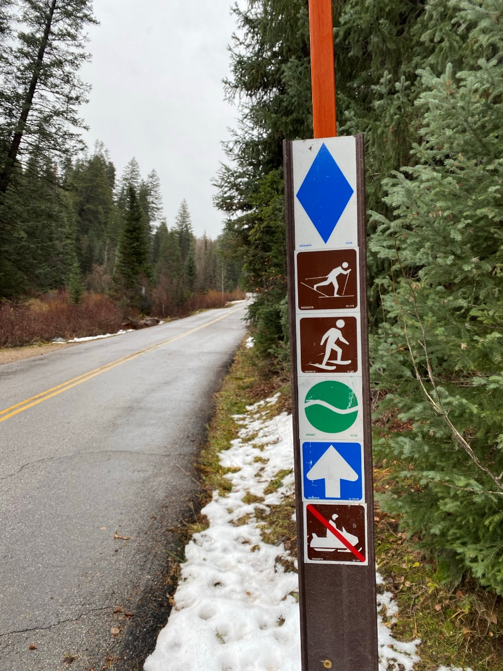
Recreation and Access
  Designated recreation sites are also Section 4(f) properties
  Key resources include:
    Picnic areas
    Trailheads
    Trails
  Preliminary considerations
    Canyon access during and after construction
    Improved access at parking areas
    Modifications to trails and trailheads
    No changes to recreation uses or opportunities
Recreation and Access
Slide 27 of 32

Slide 28
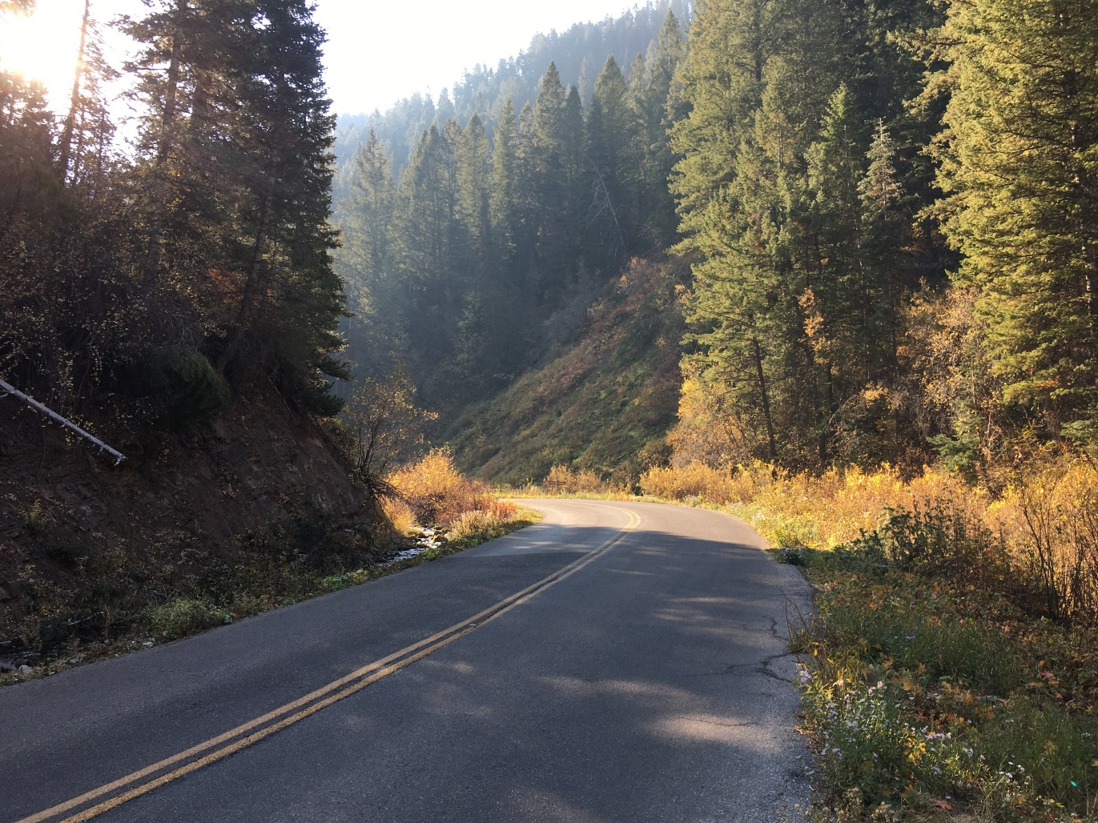
Biological Resources
  Key resources include:
    USFS sensitive species (several plants and aquatic wildlife)
    Riparian habitat
    Streams and wetlands (waters of the U.S.)
    Invasive plants
  Preliminary considerations:
    Minor habitat disturbance along road
    Potential impacts to sensitive plants
    Discharge of fill and other work in streams/wetlands
    Potential spread of invasive plants
Biological Resources
Slide 28 of 32

Slide 29
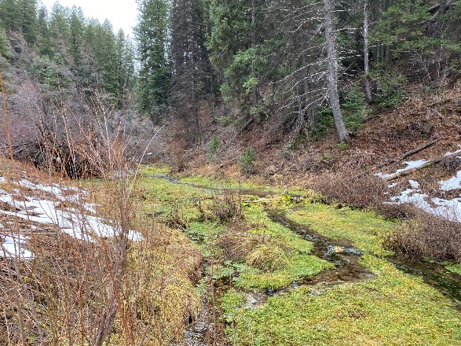
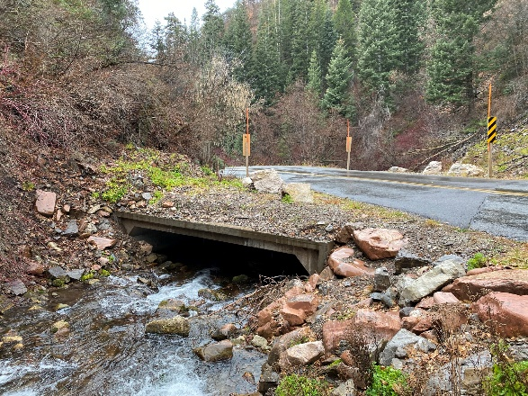
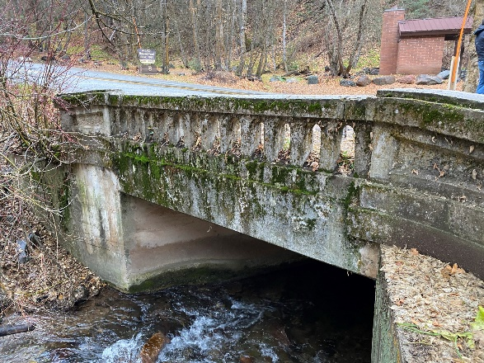
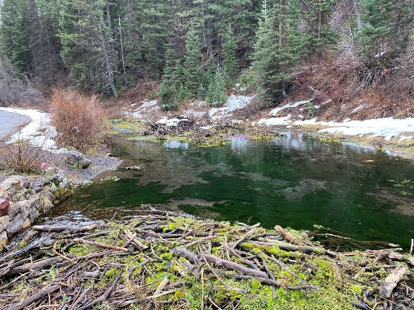
Floodplains
  Zone A 100-year floodplain around Mill Creek
  Anticipate no rise in flood elevations with drainage improvements
Water Quality
  Key resources include:
    Mill Creek and its tributaries
  Preliminary considerations:
    Temporary water quality concerns during construction
    Decreased erosion from improved drainage
    Water quality treatment at parking lots
Floodplains and Water Quality
Slide 29 of 32
Notes:
-informal parking increases erosion

Slide 30
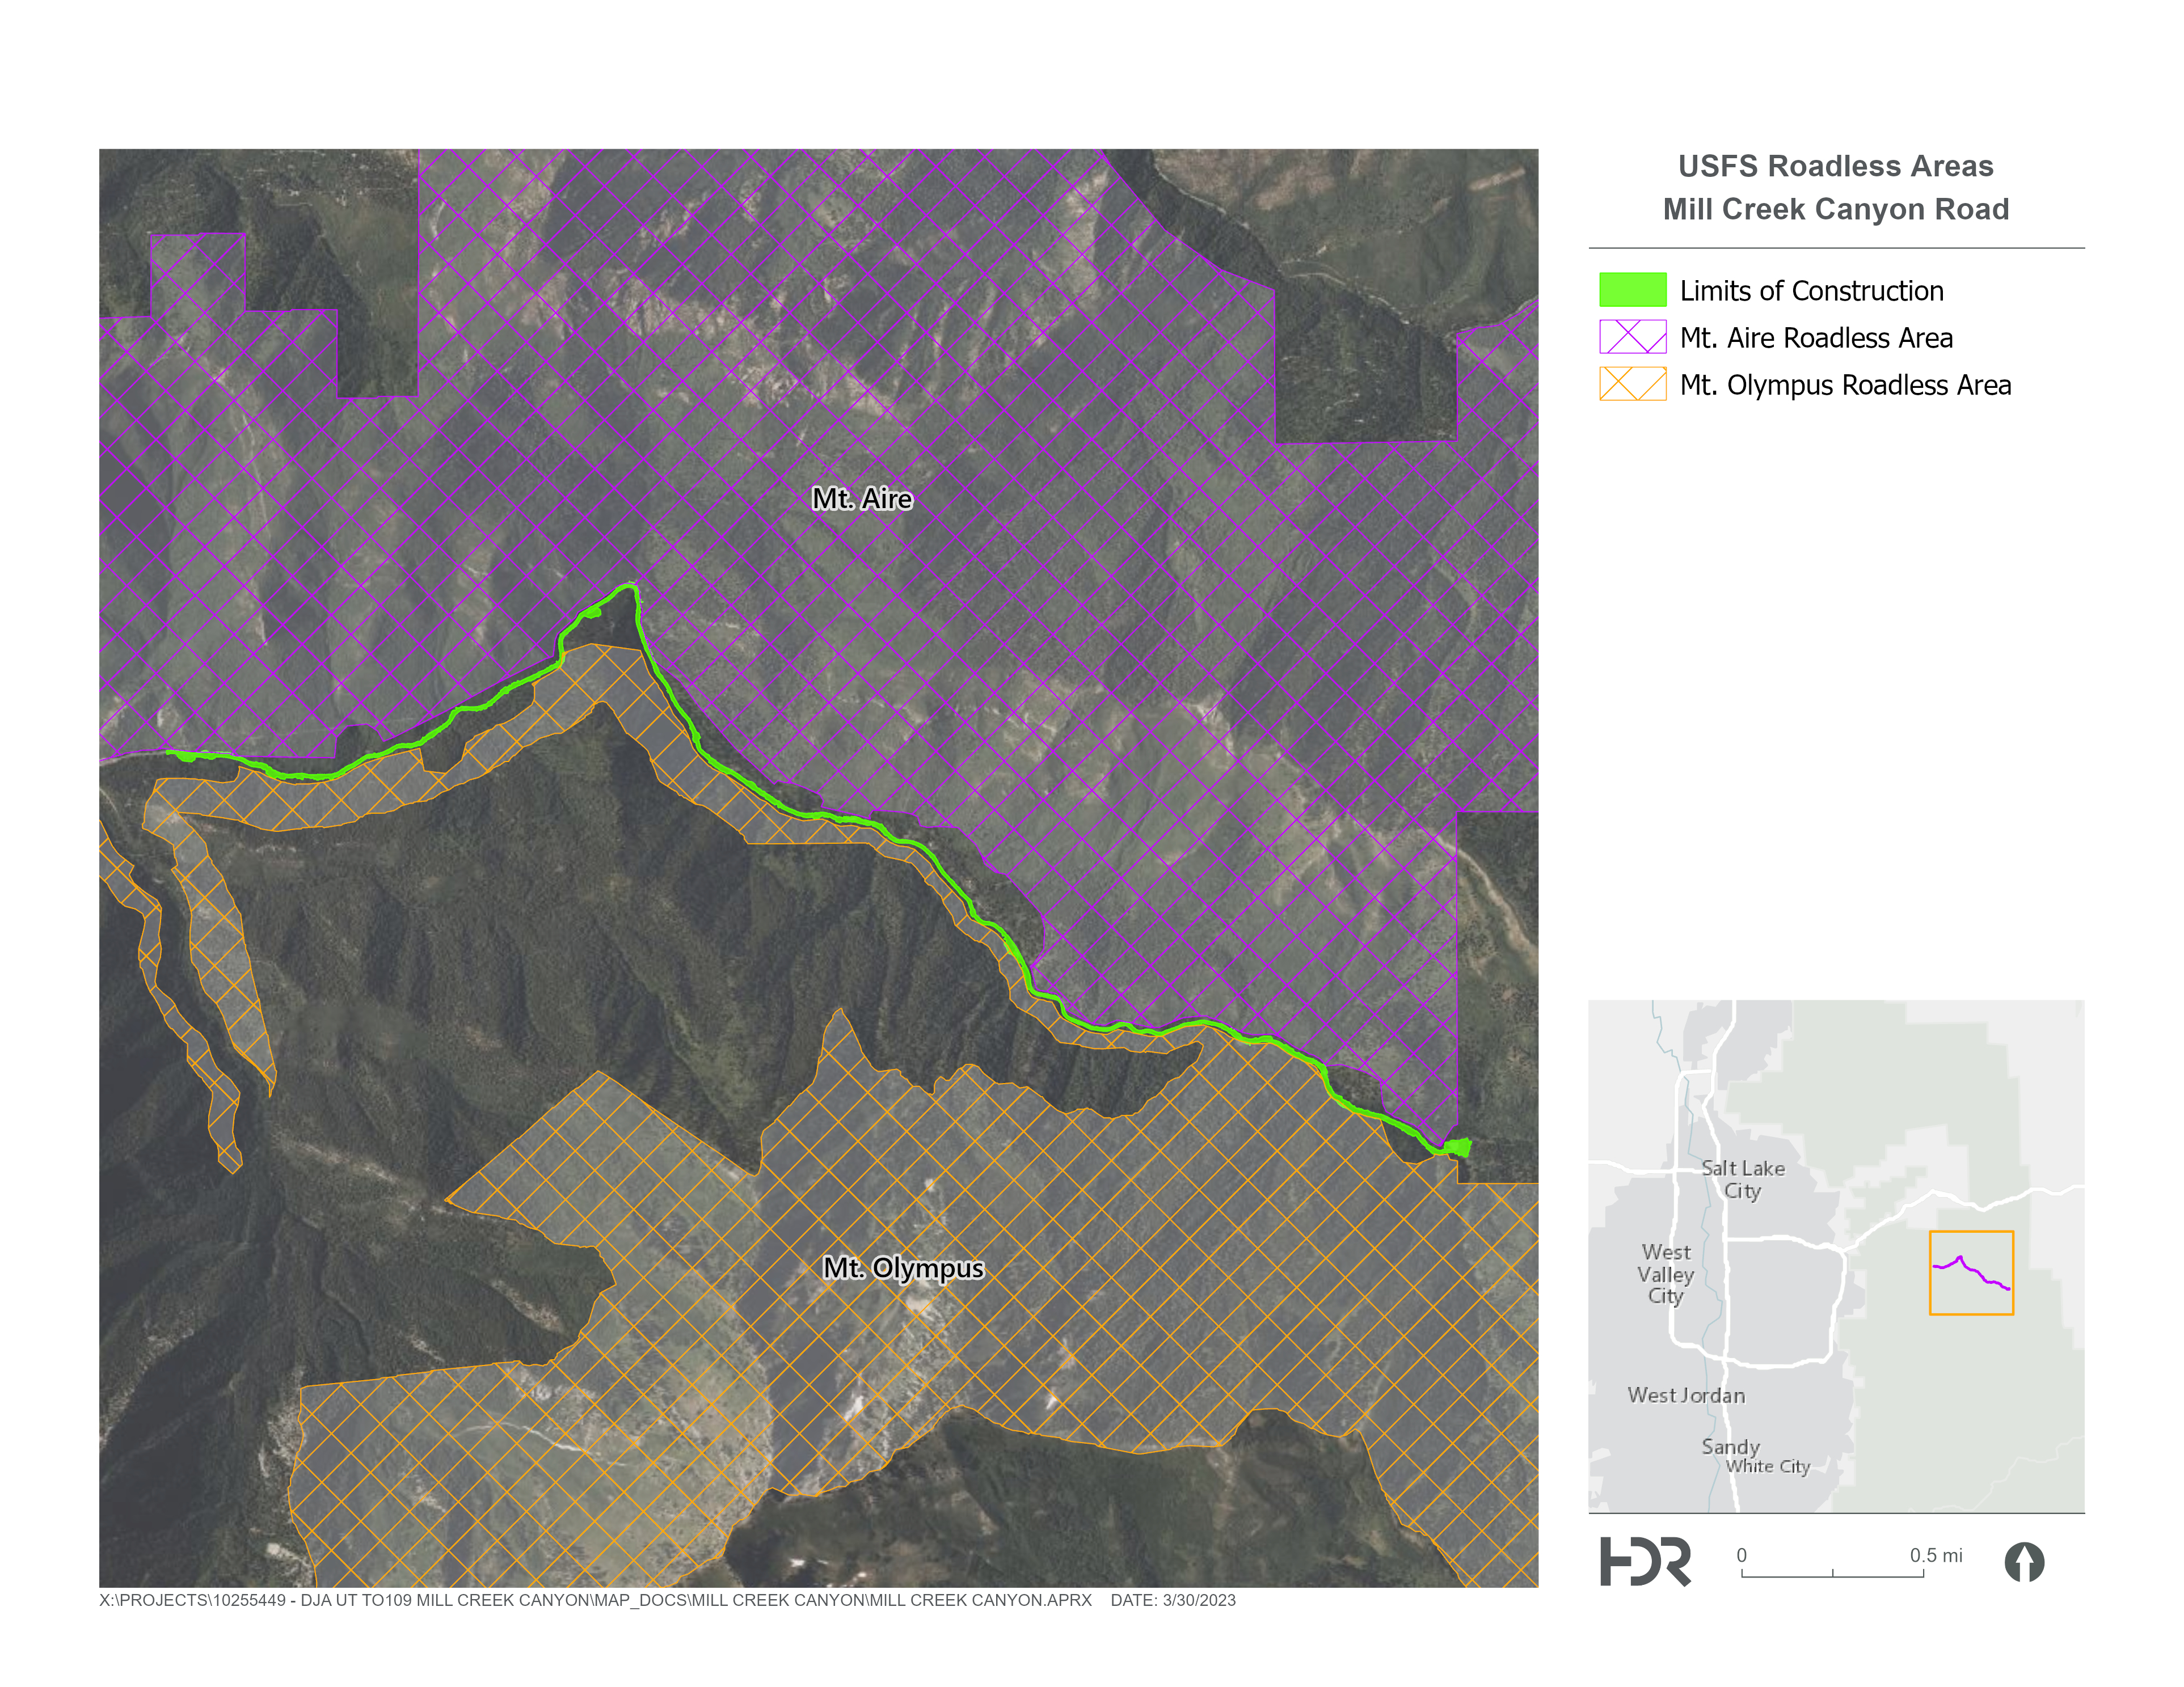
Land Use
  Key resources include:
    Plan consistency
    Existing land uses
    Inventory Roadless Areas (IRAs)
  Preliminary considerations:
    Road improvements are consistent with planning goals
    Modification of easement between the County and USFS
    Encroachment into IRAs
    Modification of uses due to expanded parking lots
Mt Aire and Mt Olympus Inventoried Roadless Areas
Land Use
Slide 30 of 32

Slide 31
Schedule
  Publish EA and finish preliminary design in Summer/Fall 2023
  Following environmental review, next steps include:
    Finish final design (2024)
    Obtain permits (2024)
    Advertise and award project
    Begin construction, est. 2024/2025
Public Outreach
  Public Meeting #3
    Meeting materials will be available online on June 15, 2023
    Comment period is June 3 through July 10, 2023
    Please provide written comments
    Ongoing consideration of comments
  Environmental Assessment
    30-day comment period
Project Schedule and Public Outreach
Slide 31 of 32
Notes:
Purpose and need – does sit meet purpose and need
Multimodal safety – to what level does it provide an improved facility for bikes and peds
Environmental impacts – what are the impacts? visual, stream, wetlands, habitat, historic resources
Construction cost – minimize construction costs, minimize ongoing maintenance costs
Design standards – does it meet design standards, there is flexibility

Slide 32
Questions / Answers – General Input
Please provide input by July 10, 2023.
Your input will be considered throughout the design and environmental process.
Fill out a comment card tonight.
Email: millcreekroad@slco.org
By mail: Salt Lake County Regional Development, c/o Helen Peters, 2001 S. State Street S2-100, PO Box 144575, Salt Lake City, UT 84114
Project Websites: https://slco.org/millcreekcanyon and https://highways.dot.gov/federal-lands/projects/ut/flap-sla-10-1
What comments and questions do you have?
Slide 32 of 32
Notes:
Be specific, what do you like or dislike specifically.
Present reasonable alternatives

